Slide 1
DrupalGem
Commerce Training
Version 1.0
Notes:
Welcome to the DrupalGem training. This training is focused on providing the info you can leverage to do your job more quickly.

Slide 2
Before the Training Session:
Read entire presentation and write answers to practice questions at the end of each section.
Send your deck with your written answers to kphimmas@estee.com before the training so you can get your login access.
Notes:
Reading the deck and providing your answers to the questions will help tailor the training to you. Based on your answers, we can focus on areas that need clarification which will make our time together more useful and efficient.

Slide 3
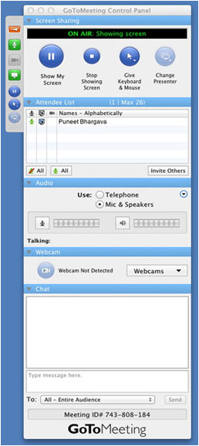
Participation Guidelines
You can ask and answer questions in the GoToMeeting control panel’s Chat section anytime during the training session.
If you have a question or feedback after training, send follow up questions to kphimmas@estee.com and we will send all questions and answers from the session within a day.
Notes:
Please submit any questions or comments you have during the training into the GoToMeeting Chat area. A recap of questions and answers will be sent within a day of training to everyone in the session.

Slide 4
Training Objectives
Concepts
Evolution of the platform Anatomy of a page Master Inheritance Subscription (country chooser only) Localization
Practice
Logging into Tools Where to make changes to media, copy and code Drupal CONTENT Workflow Edit/Add Content Adjust layout for long translations Drupal TEMPLATE CODE Workflow Getting enhancements from another site Managing assets in Alfresco Adding/Editing Resource Bundle Keys
Trouble Shooting
Common Issues Not able to login Page is blank Can’t link to an image Recovering a deleted template Recovering a deleted revision Republishing an old version Can’t save changes Subject Matter Experts How to get help
Notes:
It will take some work and practice to get used to the new platform, but we hope this training will provide a foundation for you to leverage it more quickly. The platform is constantly evolving and improving, so please provide feedback on how the platform can make your work more efficient.
We schedule training to be as close as possible in time to when you will need to apply it. You are expected to answer the questions at the end of each section before your training so you can think of questions related to your own work immediately when you have focused support.
By the end of the session, you will understand how the changes will change your work, practice making changes in the platform and how to get help moving forward. This knowledge will be validated by practicing and answering questions at the end of each section.
Any questions or concerns before we begin?

Slide 5
Getting Started
Notes:
First, let’s give you the information you need to get started.

Slide 6
Evolution of the Platform
Each Brand will move to DrupalGem as part of its Redesign.
DrupalGem Platform Goals:
More easily manage multi-device support with the proliferation of devices in the markets globally. Sites can now also share content.
Decrease time and effort to roll out enhancements and marketing programs through localization
Put more direct control of content in the hands of the business owners and agencies
Support more efficient progression of brand sites from Coresite to Coresite Plus to E-Commerce/M-Commerce
Notes:
Because of ELC Online’s rapid expansion of sites to build and maintain, the open source content management system, Drupal, was selected to adapt to this growth.
Drupal is the replacement for ELC’s legacy content management system, Media Farm. Drupal is an open source Content Management System to manage the creation, storage, and publishing of content on a website. Because of ELC’s special needs, our Drupal CMS is highly customized and has many special features unique to our platform.
The DrupalGem platform merges Drupal and ELC’s e-commerce platform, PerlGem. This platform has these goals:
- The ability to use one CMS to support PC and Mobile sites. Both sites can also share content.
- The ability to easily share content and layouts across a brand, so it will take less time to roll out enhancements across a brand’s sites around the world.
- Putting the control of content in the hands of the business owners so content changes can occur more quickly to meet business needs.
- A more efficient process to move from a marketing to an E-Commerce site. The coresite contains the core marketing brand content, which can be extended by adding a product catalog to become a coresite plus site. To enable a site for E-Commerce/M-Commerce, we then just need to add account and shopping cart and checkout capabilities instead of building an entirely new site.

Slide 7
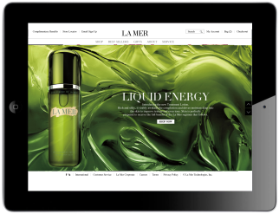
Data Flow Timing
*
¾
PRODUCT
Product
Catalog Entry (.NET)
RB Editor
Product inventory and display status remains at 5 minutes to refresh.
Product
Catalog
Database
up to
20 min
Manual
Update
Manual
Update
up to
60 min
up to
60 min
up to
60 min
Product
Cache
Product
Cache
Product
Cache
Product
Cache
Product
Cache
CODE
Manual Update
Manual Update
Manual Update
Manual Update
Perl Gem
Personal
Server
Perl Gem
ENG
Server
Perl Gem
DEV
Server
Perl Gem
STAGE
Server
Perl Gem
PRODUCTION
Server
Manual Update
Manual Update
Manual Update
up to
10 min
Publish
Drupal
Personal
Branch Server
Drupal
ENG
Server
Drupal
DEV
Server
Drupal
STAGE
Server
Drupal
PRODUCTION
Server
up to
60 min
up to
5 min
¾
Ÿ
CONTENT
Drupal Code Integration engineers can manually sync content down to all environments instead of waiting up to 60 minutes.
Manual sync will be available in the Drupal interface by end of FY14
Alfresco
Drupal
Content
Entry
Media
Repository
Notes:
This chart will serve as your visual resource for the content/code flow and timing for our DrupalGem platform.
To our original PerlGem application servers and product catalog, we integrated Drupal servers where code pushes through similar server environments as PerlGem. Content entry in Drupal flows the other direction down the servers, but we’ll discuss that more later. We have also replaced webdav with Alfresco for web asset management and upgraded the interface of the Resource Bundle Editor.
Let’s walk through the diagram in more detail.
Drupal Content Entry flows directly onto the Production Server. Saved draft content is on production immediately but only visible through revision tags. Published content is displayed publicly on Production within 10 minutes.
From the production Drupal server, content updates backwards to the other servers (eng, dev, stage) and updates them every hour on the hour. For example, if you need to see your content on dev, enter it into the CMS and wait for the hourly update. Then, sign in to dev to see the content by revision tag. Drupal Code Integration managers can manually sync content down to all environments. Please see SME contact list for who can do this.
3) One instance of Alfresco exists for all environments. Assets are uploaded during content entry directly on to Drupal. Assets uploaded from Alfresco can take up to 5 minutes before they are viewable in the Drupal interface, then another hour to sync back to all environments other than Production. Assets uploaded in an environment other than Production will NOT be deleted during the hourly content update-they will still remain on the Alfresco server. Please note that if you delete a file from alfresco, it will still be accessible via the Drupal interface.
4) Engineers currently can manually sync content from production down to the lower environments of eng, dev, stage and production. This will available through the drupal interface by the end of FY14.
The following things remain unchanged:
- Updates to the Product Catalog may take up to 20 minutes to show up in the Product catalog database.
- Updates from the Product catalog database can take up to an hour to appear on the dev, stage and production servers. They must be manually updated on the eng server and your personal server.

Slide 8
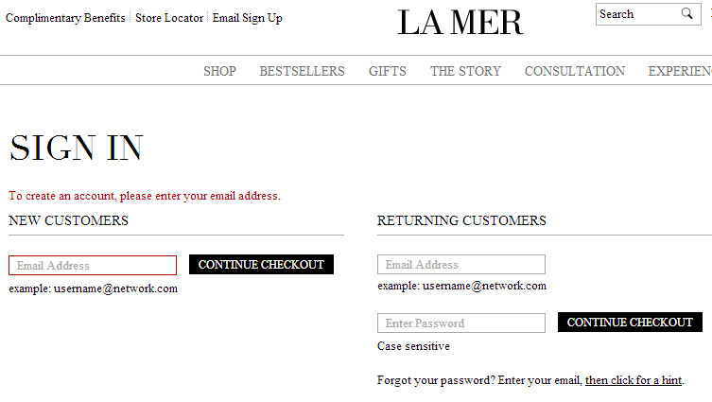
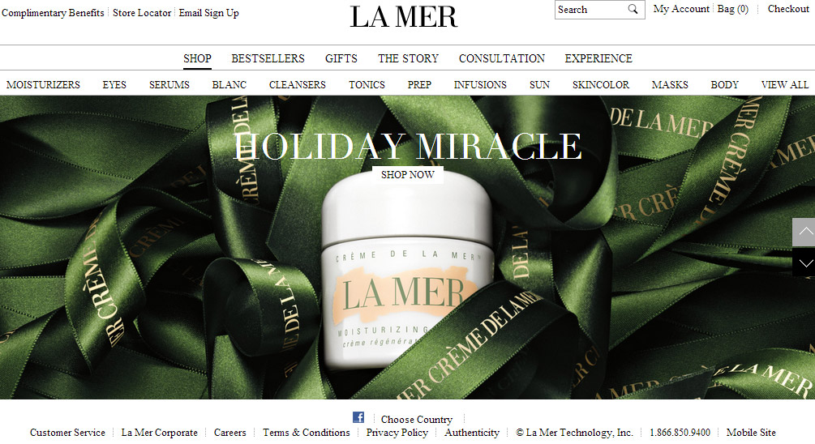
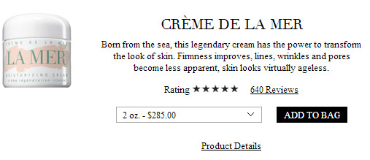
Where do you go to edit content?
These are general guidelines. Consult brand rollout kit for specifics.
Drupal CMS | Alfresco | RB Editor | Product Catalog
Homepage Navigation Merchandising windows Content pages (about, customer service, video) Store locator layout and copy Special content on MPP, SPP Content NOT in account, checkout or product data Load single assets into content area | Bulk loading image files Bulk loading video files | Copy in Account Copy in Checkout Error messages in Account and Checkout | Category data Product data SKU data Store data
* Ratings & Reviews are pulled from Bazaarvoice
Notes:
These are general guidelines for where to go to edit content. Please consult each brand’s rollout kit for specifics. You may need to touch several tools in order to update content.
In the Drupal CMS, you can edit homepage, navigation, merchandising windows and content pages on a site. As a general rule, we’ve put any content outside of checkout and account that is NOT product catalog related in the CMS.
Alfresco is the replacement for webdav. It’s used to bulk load and manage assets such as images and video. You can upload assets one at a time through the Drupal interface which we will cover in an example.
Any information related to categories, products or SKUs or store locations are edited in the product catalog manager (.NET).
The (RB resource bundle) editor is used to edit copy within checkout, account and error messages.

Slide 9

Tools Access Levels
All new tools require an RSA token to login
EXCEPT Alfresco which has a different username and password.
ROLE | Alfresco | RB Editor | Drupal Content Translator | Drupal Content Editor | Drupal Content Approver | Drupal Content Publisher* | Drupal Template Editor | Drupal Brand Admin | Drupal Site Creator | Drupal System Admin | Server Access | HipChat
DESCRIPTION | Load Assets such as images, video | Edit Text not in .NET or Drupal | Edit Existing content only | Create / Edit draft content | Approve draft content | Approve / Publish to the LIVE site | Write Code and affect templates | Edit CMS taxonomy (edit/ remove sections) | Edit Site Wizard | Platform Engineer Only | Engineer only | Group chat
RECOMMENDED FOR | All users | Agency Producer Engineer | Translators | All users EXCEPT Translator | All users EXCEPT Translator | All users EXCEPT Translator and Designer | Agency FE Maint Eng FE Dev Eng | Agency Producers Brand Maint Eng Dev Eng | Ph 1 Eng SME Ph 2 Eng SME Ph 2.5 Eng SME Dev Eng | Please route through Laura Leslie | Route requests to ELC admin for these servers: njleng01 njdevdrp01 | All users
* Publishing permissions should only be granted to users with the capability to update the LIVE site.
Notes:
The RB Editor and the Drupal CMS (content management system) now require an Estee Lauder issued RSA token to login. If you already can login to the offer manager, you can use that same login for the RB Editor and Drupal CMS.
If you have an Estee issued RSA token but have never logged into the offer manager, RB Editor or Drupal CMS, please provide the ID number on the back with your account access request. Alfresco does not use RSA, so you will be given a separate login/password for that system.
This chart shows what each role does as well as who the role is recommended for. You can have multiple roles. Please review the chart to see which access you will need.
Old logins to access existing tools remain the same (Bugzilla, Endeca, BV, etc)

Slide 10
URLs
Drupal CMS and Site Environments
FORMAT: https://[e].[brand].[region or locale].[environment].[datacenter for dev and stage URLs].elcdev.net
PRODUCTION CMS: https://e.jomalone.emea.fr.cms.elcdev.net/user
TO REVIEW BY REVISION TAG: http://e.jomalone.emea.fr.cms.elcdev.net
PERSONAL SERVER: e.jomalone.jp.kknudsen.eng.elcdev.net
ENG: e.jomalone.emea.fr.eng.elcdev.net
DEV: e.jomalone.emea.fr.dev.emea.elcdev.net
STAGE: e.jomalone.emea.fr.de.stage.emea.elcdev.net
WWWTMP: wwwtmp.jomalone.fr
http://www.jomalone.fr
'e' denotes e-commerce site
'm' denotes mobile
'c' denotes coresite
Alfresco
Please note that alfresco does NOT use RSA login. It’s a separate login/password.
http://alfresco.elcdev.net/share/page/
RB Editor
https://tools.elcompanies.com/
You can see the keys inline on the site by adding this to the end of a DEV URL /shared/setkeys.tmpl
Notes:
These are URLs to the new tools.
There is common format for our Drupal Gem test environment URLs.
- a c, e or m at the beginning of the URL stand for coresite (c), an E-Commerce desktop site (e) or a mobile site (m).
- brand stands for a brand name such as clinique
- region stands for the region abbreviation like emea for multisite
- locale stands for the specific locale such as de for Germany
- environment stands for eng, dev, stage, wwwtmp
- datacenter stands for the datacenter abbreviation such as ncsa for north america, uk for uk/emea, cntel stands for china and kidc stands for the Korean datacenter
Please note there are exceptions for china and UK sites that only list 'uk' or 'cn' once.
Alfresco is the new web asset management system that replaces webdav. This URL is how you access where you can load images, videos and other media assets for use on the sites. Please note that alfresco does NOT use RSA login. It’s a separate login/password.
RB (resource bundle) editor has a new interface and is available at https://tools.elcompanies.com/.

Slide 11
Getting Started Questions
What is the DEV URL for Jo Malone Japan Mobile site?
What is the production URL for the Jo Malone Japan CMS?
What URL would you go to in order to edit this error message? 'Please enter your password.’
How long will it take for a Drupal content change to appear on the DEV site?
What are the goals of DrupalGem?

Slide 12
Logging In
Notes:
First, let’s give you the information you need to get started.

Slide 13
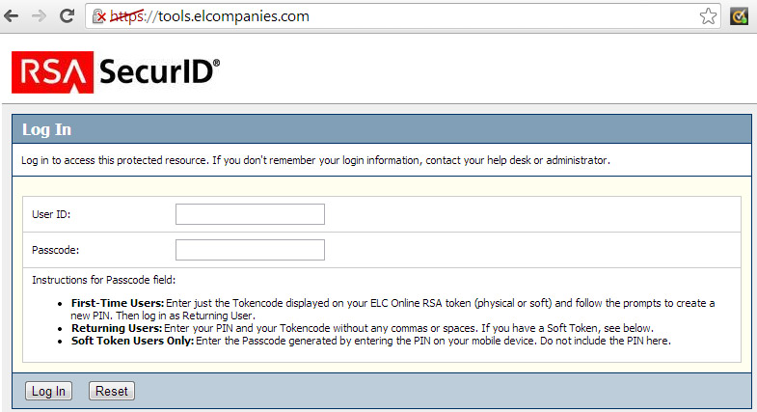
Logging in for the first time
Notes:
In order to login to the tools, you will need
Estee Lauder issued RSA token
A username associated with your RSA token given to you by the ELC Online Admin (elconlineadministration@estee.com).
Go to https://tools.elcompanies.com/. This is the only place where you can login for the first time.

Slide 14
Creating a new PIN
Username such as 'lewong'
Notes:
Enter your username in the user ID field
Enter just the 6 digit token code displayed on your ELC Online RSA token
Click log in button
Follow directions to create a new PIN. The PIN is 8 digits and the same PIN you use to SSH into the server. The PIN is different than the 4 digit PIN you use to access Estee email through a browser.

Slide 15
Signing in as return user
Username such as 'lewong'
Notes:
The same login works for any of these tools. We show the Drupal CMS login in the screenshot below.
RB Editor and Offer Manager: https://tools.elcompanies.com/
**Drupal CMS: https://e.cremedelamer.cn.cms.elcdev.net/user
**Please note you will need to enter the brand login/pw to see the login page.
Enter your username in the user id field and your 8 digit PIN + 6 digit tokencode in the passcode field and click the Log In button

Slide 16
When you can’t login to Tools URL
Username such as 'lewong'
Notes:
If there are 3 or more failed login attempts on the tools URL (https://tools.elcompanies.com), your RSA account will become locked. If it is locked, contact the ELC online admin elconlineadministration@estee.com (9am – 6pm NY ) to put your account in new PIN mode.
In APAC, you can contact Esther Leung or Quin Shing to reset your token.
In UK, you can contact Mark Lapicki to reset your token.
In EMEA, you can contact Mark Woods to reset your token.
Once that’s done:
Go to https://tools.elcompanies.com/
Enter your username in the user ID field
Enter just the 6 digit token code displayed on your ELC Online RSA token
Click log in button
Follow directions on the screens to create a new PIN.

Slide 17
When you can’t login to Drupal/Alfresco
Username such as 'lewong'
Notes:
If you need to set a new PIN because you can’t remember yours, you will still need to contact the ELC online admin elconlineadministration@estee.com (9am – 6pm NY) to put your account in new PIN mode.
In APAC, you can contact Esther Leung or Quin Shing to reset your token.
In UK, you can contact Mark Lapicki to reset your token.
In EMEA, you can contact Mark Woods to reset your token.
Once that’s done:
Go to https://tools.elcompanies.com/
Enter your username in the user ID field
Enter just the 6 digit token code displayed on your ELC Online RSA token
Click log in button
Follow directions on the screens to create a new PIN.

Slide 18
Logging In Questions
Based on your role, what access will you need?
What do you need in order to login into the DrupalGem tools (RB Editor, Drupal CMS, Offer Manager)?
Who can you contact to reset your RSA token in your region?
How long is your RSA PIN?
Which sites first require the brand site credential authentification before entering in your own RSA credentials to access them?

Slide 19
Editing Drupal Content
Notes:
Since it’s the newest topic, let’s start with editing content and code in Drupal.

Slide 20
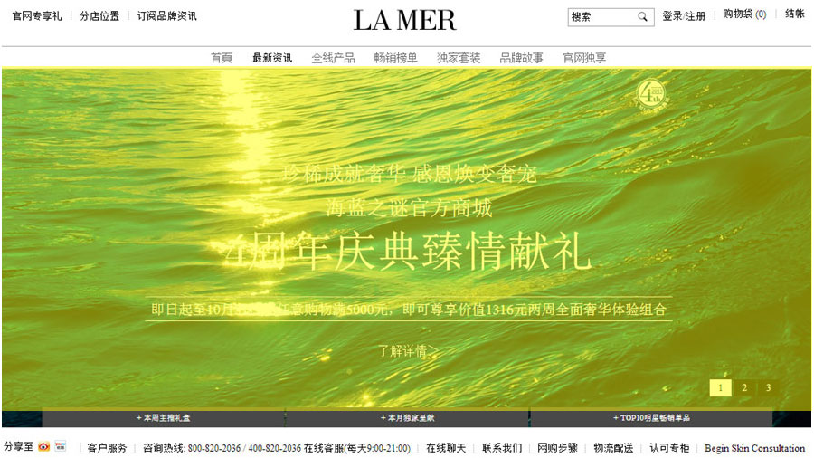
Homepage slideshow content
Notes:
Let’s use updating the homepage slides as an example of how to edit content in Drupal.
First, go to the DEV environment to see what content exists currently.
http://e.cremedelamer.cn.dev.cntel.elcdev.net/

Slide 21
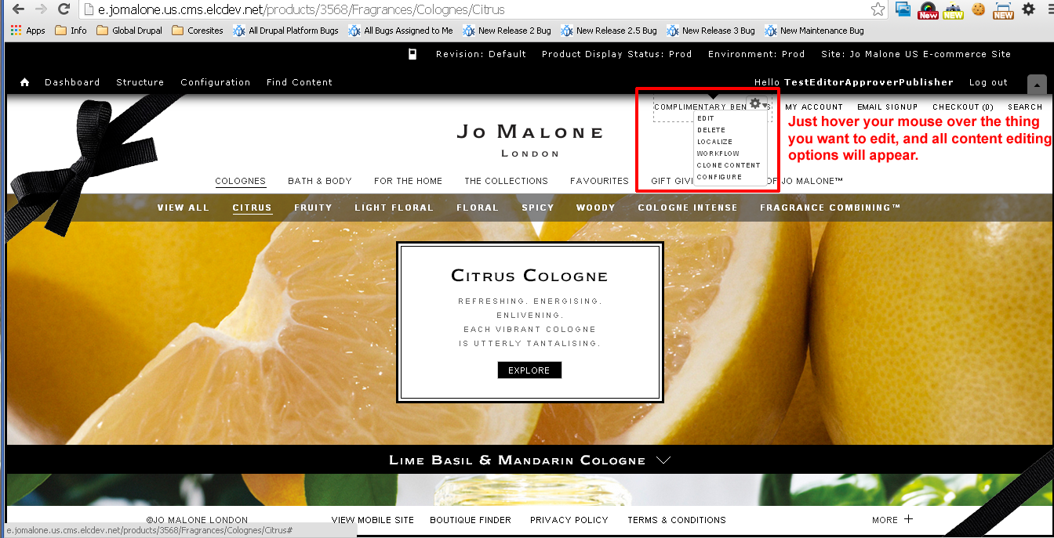
FIND: Content Contextual links
Notes:
To find content you want to edit, you can view the site through the CMS and hover over the content you would like to edit and you can take action on it immediately.

Slide 22
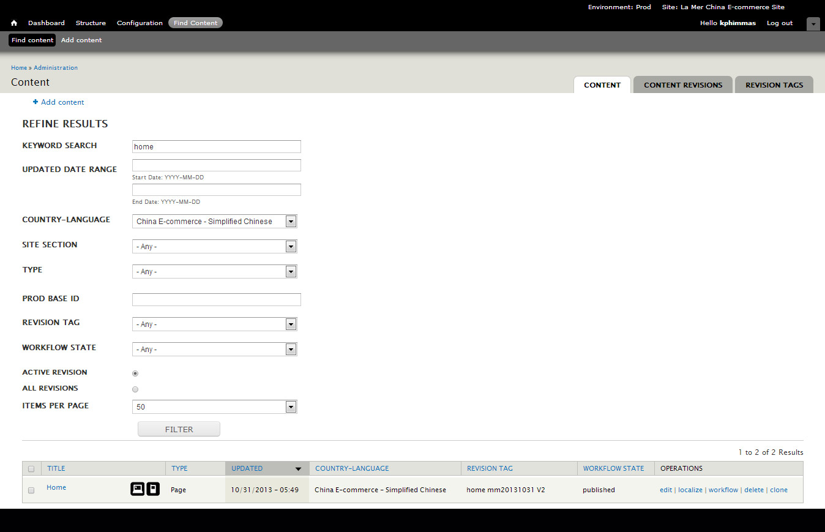
FIND: Homepage slideshow content
Notes:
In order to edit the homepage slideshow content, we need to login to the site’s production CMS which is
https://e.cremedelamer.cn.cms.elcdev.net/user
Once you log into the CMS, make sure you are in the 'Prod' environment and on the correct site. In this case, La Mer China E-Commerce site. In Drupal, changes are copied to production first then synced back to other environments on an hourly basis.
Click the ‘Find Content’ link in the CMS navigation.
3. Enter the keyword 'home' to find every piece of content related to the homepage.
4. Click filter and you will see content that matches your search below.

Slide 23
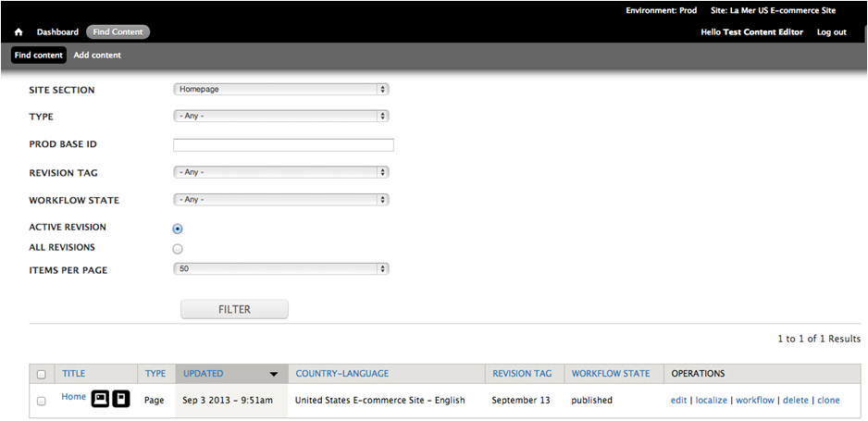
VIEW: Homepage slideshow content
Notes:
Click the ‘Edit’ link to view the published content of the page. Because it’s not possible to edit approved, published, unpublished content, clicking edit will automatically create a new DRAFT REVISION of the page.
If the content is not approved, published, unpublished (e.g. draft), you can edit that draft revision directly by clicking edit.
If you want to make a backup of the draft revision, click workflow link instead and click 'COPY TO NEW DRAFT'

Slide 24
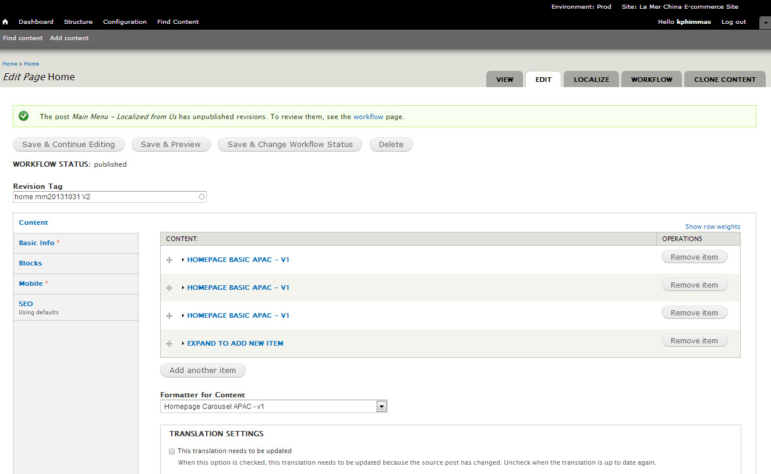
CREATE REVISION: Homepage slideshow content
Notes:
The first thing you should do before you edit any content is to name your REVISION. In this case, I clicked to ‘Edit' a published piece of content so it created a DRAFT REVISION that has the old revision name. You must change the revision tag name before editing content.
To do this, just enter a new name in the revision tag field and then click the 'Save & Continue Editing' button.
It’s best practice to name revision tags according to this guideline. You can include spaces in your revision tag names.
YYYY MONTH Description
Here are some examples:
2013 October Serum_Refresh
2013 October 4 Serum Refresh
2013 November Holiday Refresh
2013 December VideoAdditions
If you name all the content for a site refresh with the same name, it makes it much easier to track, review, approve and publish content together. For example, if you need to make changes to the homepage, what’s new and MPP for your holiday refresh, name all the revision tags for each piece of content the same thing. For example:
Home – revision tag is ‘2013 November Holiday Refresh’
What’s New – revision tag is ‘2013 November Holiday Refresh’
MPP All products – revision tag is ‘2013 November Holiday Refresh’

Slide 25
EDIT: Homepage slideshow content
Notes:
On the page, you will see a list of content. Each link represents one slide in the homepage rotation.
Click on the title of each item to expand/collapse and see more details and edit the content of each slide.
You will also see the Formatter for the content at the bottom of the page. This is the template arranges how the slides are rotated.

Slide 26
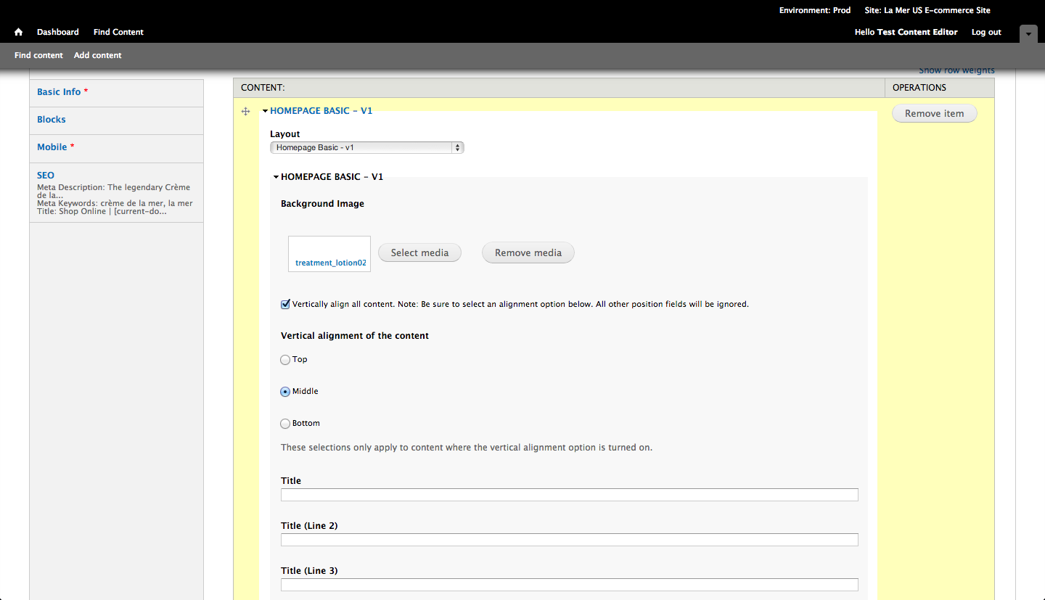
EDIT: Homepage slideshow content
Notes:
When you expand each slide content, you can edit the following for each slide.
Layout – this dropdown provides all potential layouts for the single slide. Please note the dropdown shows all pages, so look for a similarly named layout. For example, all slide layouts start with 'Homepage…' When you select a different layout, the content you can edit refreshes below.
In this example, the slide is 'basic' and just has a background image that can be aligned vertically.

Slide 27
LINKING ASSETS: Homepage slideshow content
Notes:
In order to change and update media assets (such as images, videos, or PDFs) you’ll need to use Alfresco (our replacement for WebDav). Content created in Drupal by Producers or by Engineers both use Alfresco, and can be managed in two locations:
The Drupal CMS web interface. This is the most common way to access Alfresco for day-to-day updates.
If you click ‘Select Media’ you’ll be able to browse assets already in Alfresco, or upload a new one directly to Alfresco.

Slide 28
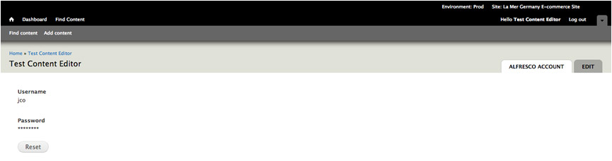
ASSETS: Homepage slideshow content
Notes:
Please note that you’ll need to reset your Alfresco access within the CMS whenever you log in. To reset your Alfresco log-in, you will:
Log into Drupal CMS
Click the hello {user login} in CMS admin navigation
Click the Alfresco tab
Click the Reset button
Enter your Alfresco username + password and click the Reset button
This reset is a temporary fix and you will not have to do this in the future. Until then, please remember to go through this process whenever you log in to the CMS.

Slide 29
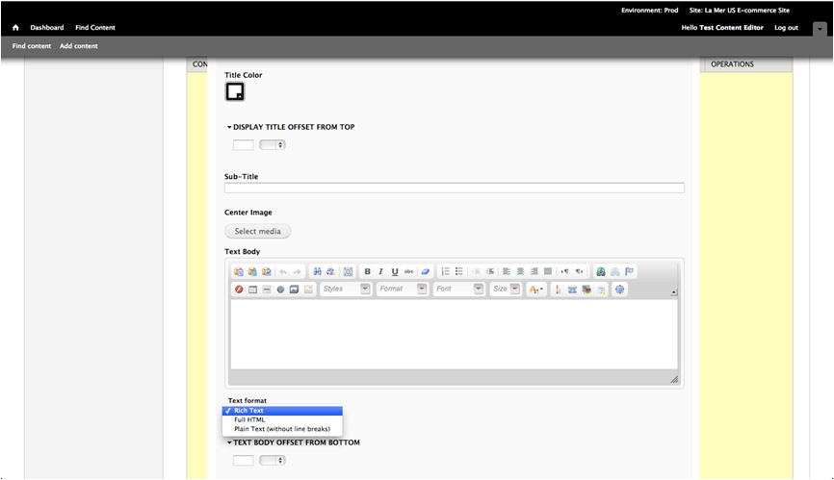
EDIT: Homepage slideshow content
Notes:
The Rich Text option allows you to edit content with a Rich Text Editor. The Rich Text Editor includes buttons for embedding images and products, formatting text, mapping images, and inserting links.
Please note that it’s best practice NOT to hard code any images or links into this window. Images or links should be separate input fields in the template itself so it can be more easily re-used.
You can also edit in full-screen by clicking the last button on the second row of the Rich Text Editor.

Slide 30
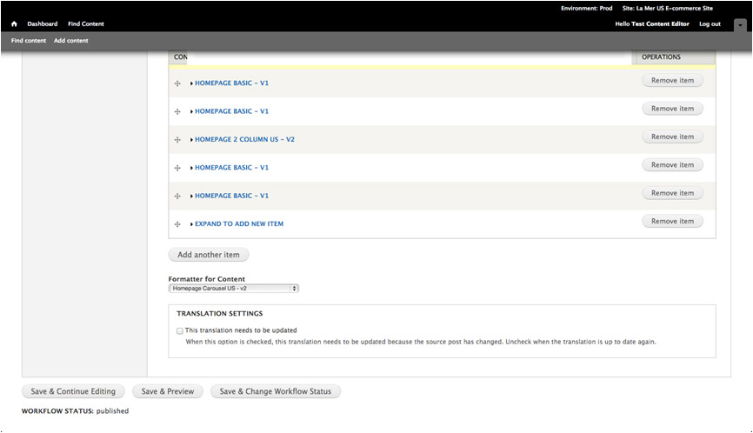
REVIEW: Homepage slideshow content
Notes:
After updating your specific content, you must take the following steps before you should publish it:
Click the ‘Save & Preview button’ at the bottom of the page
This will display a preview of your changes in the same window.

Slide 31
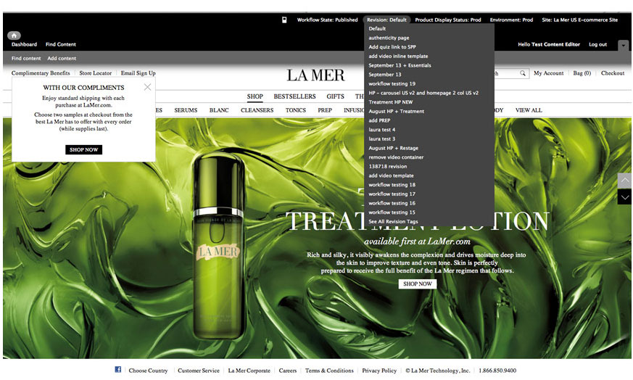
REVIEW: Homepage slideshow content
Notes:
Click ‘Revision’ in the CMS navigation.
The list of revisions are ordered by last updated, so the last revision that was made will appear in the list first.
Select your revision tag from the dropdown list. This list includes the most recently created revision tags.
Everything tagged with this revision tag will show up on this version of the site. This is the best way to review your work before publishing it.

Slide 32
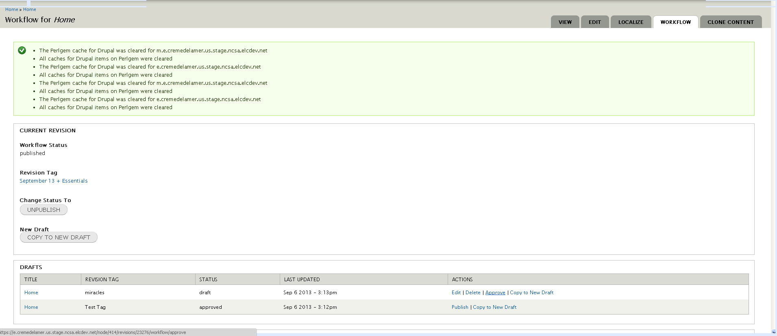
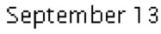
APPROVE: Homepage slideshow content
Notes:
After reviewing your work by revision tag, click “Find Content” tab to find your content. Next to the content, click the 'Workflow' tab to get to the screen where you can approve changes.
Click the ‘Approve’ link of the workflow page to view the update status page.
Please note that you can currently only action upon one piece of content at once. The ability to act on multiple pieces of content by the end of FY14 Q3.

Slide 33
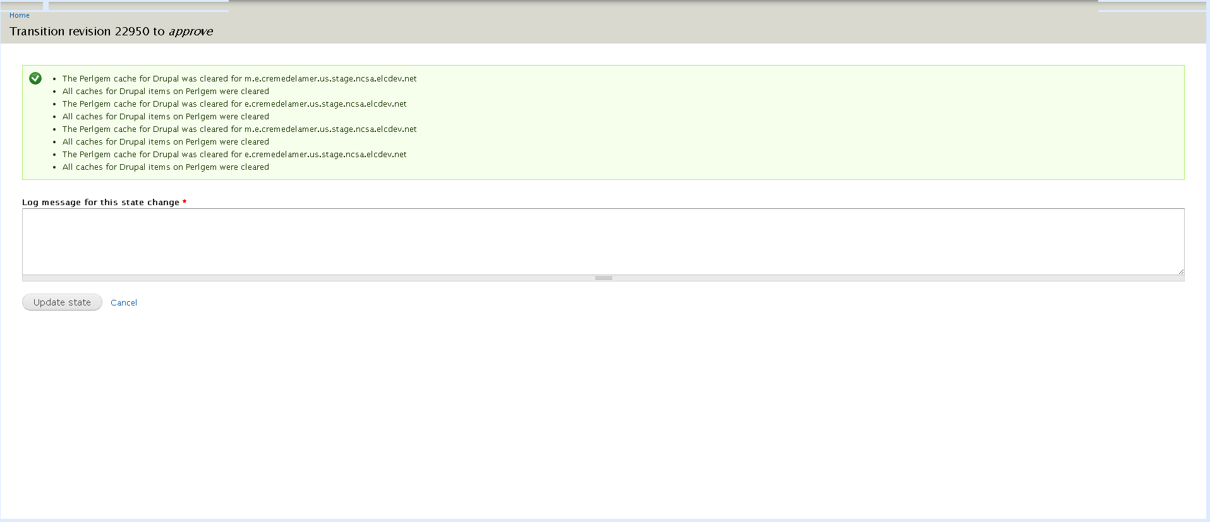
APPROVE: Homepage slideshow content
Notes:
Input your comments and then click the ‘Update state’ button.

Slide 34
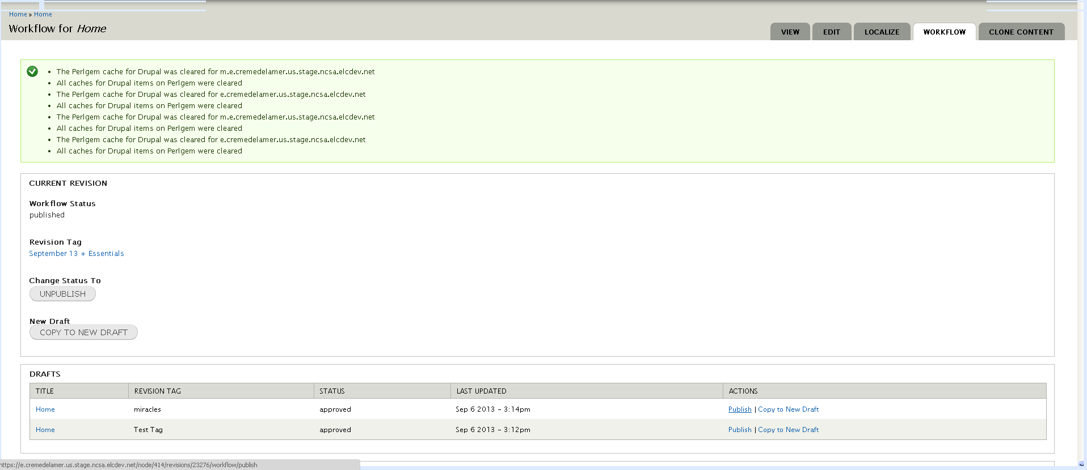
PUBLISH: Homepage slideshow content
Notes:
Click the ‘Publish’ link.

Slide 35
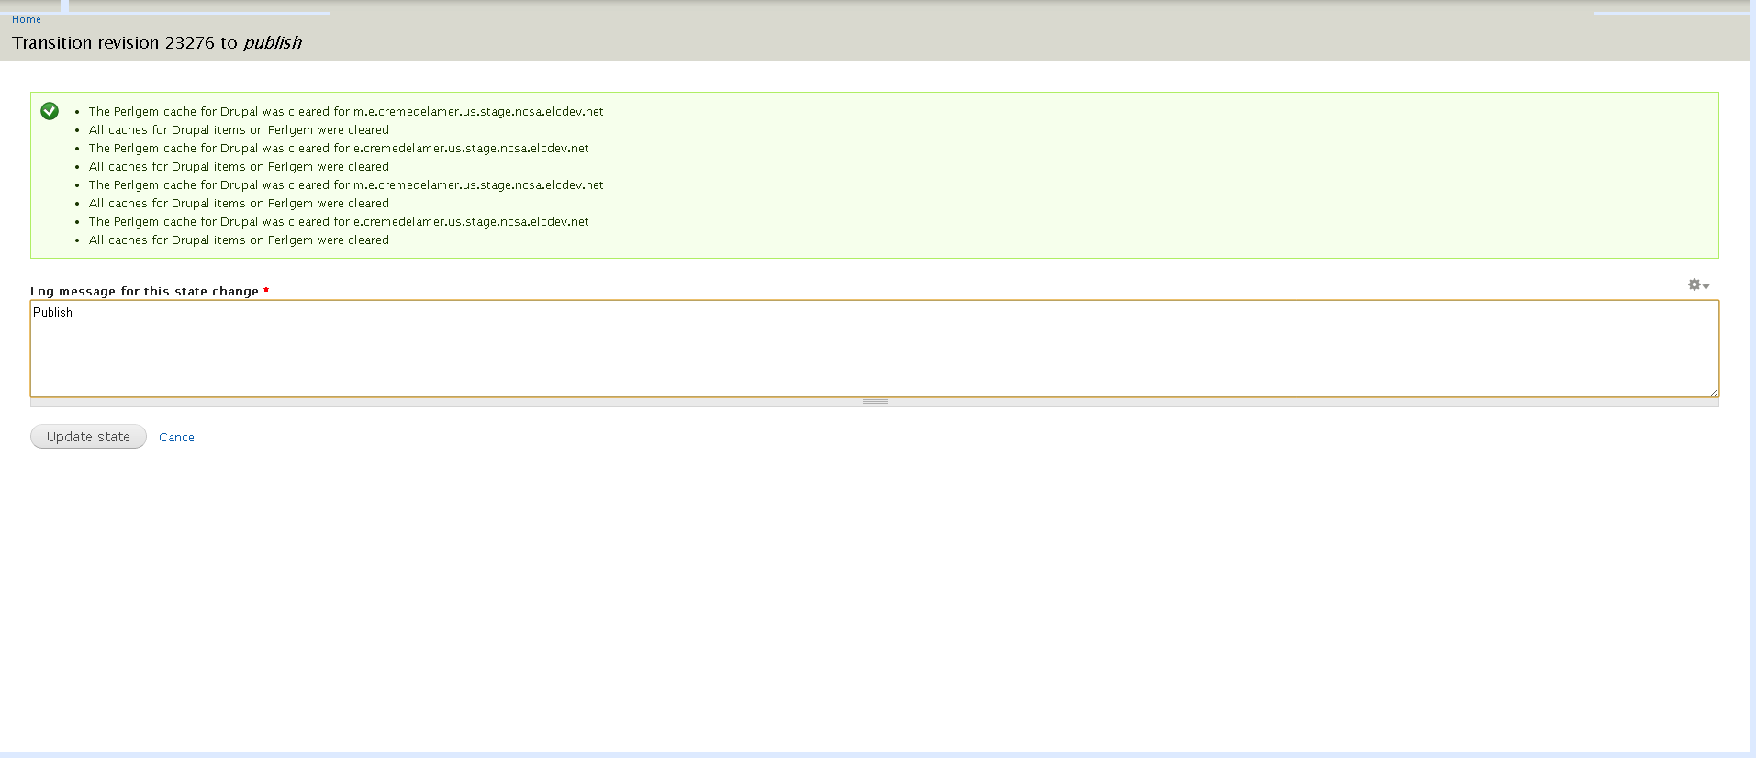
PUBLISH: Homepage slideshow content
Notes:
Input your comments and click the ‘Update state’ button to publish. It will take up to ten minutes for your updated content to appear production and up to an hour to appear on eng, dev and stage.
You will need to repeat this process to publish each update.

Slide 36
Drupal CONTENT Workflow
DRAFT REVISION
EDIT
REVIEW
APPROVE
PUBLISH
LIVE in 10 min
ALL ENV in 1 hr
UN-PUBLISH
Removes the page from the LIVE site
Version still exists as a revision
VERSIONS
Notes:
It’s necessary for content editors to know and practice the Drupal CONTENT workflow, It’s also necessary for engineers as well since code can only be viewed if it is used in content. More on that process in the TEMPLATE CODE workflow.
First thing you need to know is that when you want to test changes to content, you do NOT COPY content. Copying (cloning content) will remove all links to other content such as global header, footer etc. If you want to test making changes to content, create a REVISION of the DRAFT you are working on. We will demonstrate this later.
All Drupal content goes through a specific workflow. Drupal CONTENT workflow starts by creating a draft revision, then approving the revision, then publishing the revision to the live site. This content workflow is managed on the workflow tab within DrupalGem.
For example, a brand may need the ‘What’s New?’ page updated. Following the workflow, the editor would create a new draft revision in DrupalGem, the business team would approve the draft revision by revision tag (either by marking it as approved in the CMS or letting the Agency team know), and then the content publisher would publish it to the live site.
If the published version has a mistake, a previous version can be republished or an updated draft can go through the workflow and be published.

Slide 37
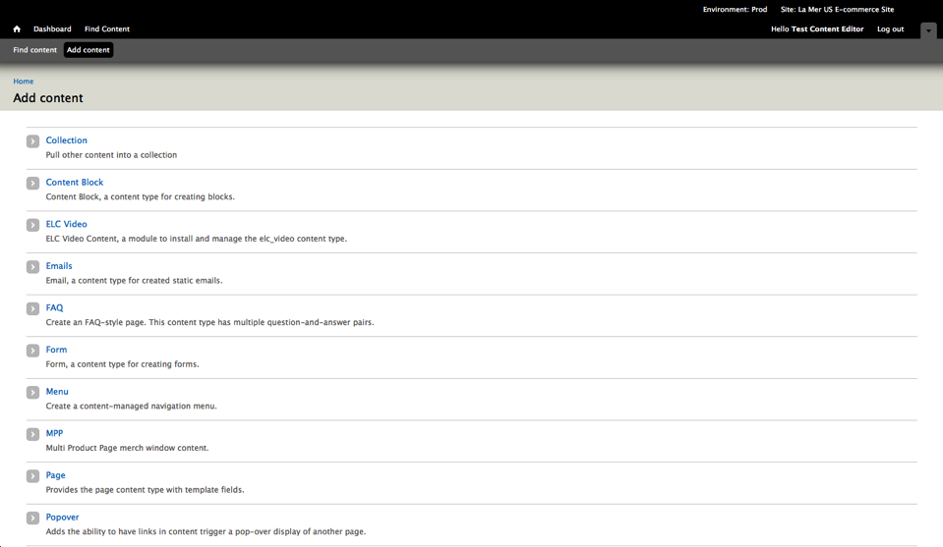
Creating New Content
Notes:
Choose what type of content you wish to add…
Collection is used on the Jo Malone site to create multi-product pages on the site that contain products as well as content. Here are a few examples.
http://www.jomalone.com/products/3574/Fragrances/The-Collections/Citrus
http://www.jomalone.com/products/3553/Fragrances/Cologne-Intense
http://www.jomalone.com/products/3644/Bath-Body/Vitamin-E-Collection
Content blocks are small pieces of site content that can be placed in various places on the site. A few examples are the complimentary benefits areas on jo malone and la mer and the email sign up popover.
http://www.jomalone.com
http://www.cremedelamer.com/
ELC Video allows you to embed one video using a standard video player that works across devices and browsers. An example is the kelp harvest video on la mer.
http://www.cremedelamer.com/kelp-harvest
Emails are used to create static system emails such as welcome emails.
FAQ is used to create a question and answer style page. http://www.jomalone.com/faq#fragcomb
Form allows you to create pages with forms for submitting user data, such as email signup and opt out, sweepstakes, and “Contact us”.
Menu allows you to create navigational menus like a main menu, a footer menu, or a sub menu that appears on a limited number of pages.
MPP allows you add merchandising windows that appear above the product grid of a standard MPP.
Page is the most popular content to add. You can manipulate the body content of a page while including the site’s header and footer. The most common example is the homepage.
http://www.jomalone.com/
Popover is content that pops open when triggered from on other pages of content.
Translation Set is and inline Javascript templates used on product pages. An example is the complimentary benefits, share and customer service area on the single product page. http://www.cremedelamer.com/product/5834/12343/Moisturizers/Crme-de-la-Mer/Ultrarich-Cream

Slide 38
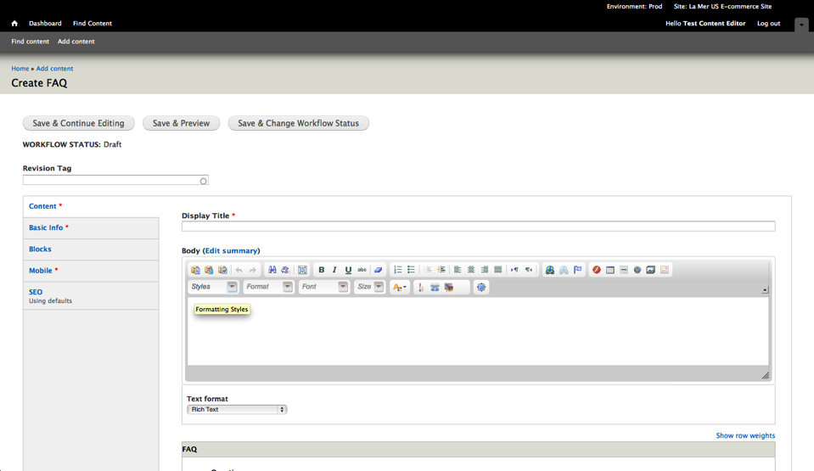
Creating New Content
Notes:
From here, add the new content on the Content tab. This includes any copy and media files, making sure to fill out any fields that are required. In this example, an FAQ page, a Display title is a required field, as indicated by the asterisk.

Slide 39
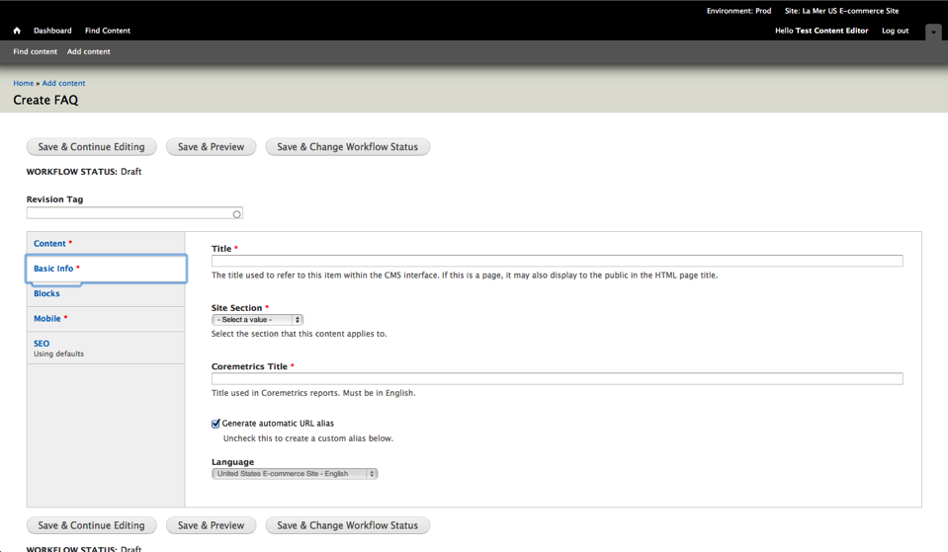
Creating New Content
Notes:
You will also need to fill out the basic info page with items such as the Title and Site Section.
When you are finished entering all of your content, you will follow the same steps we used in Updating the Homepage and Updating the Complimentary Benefits Layer to review and publish your new content.

Slide 40
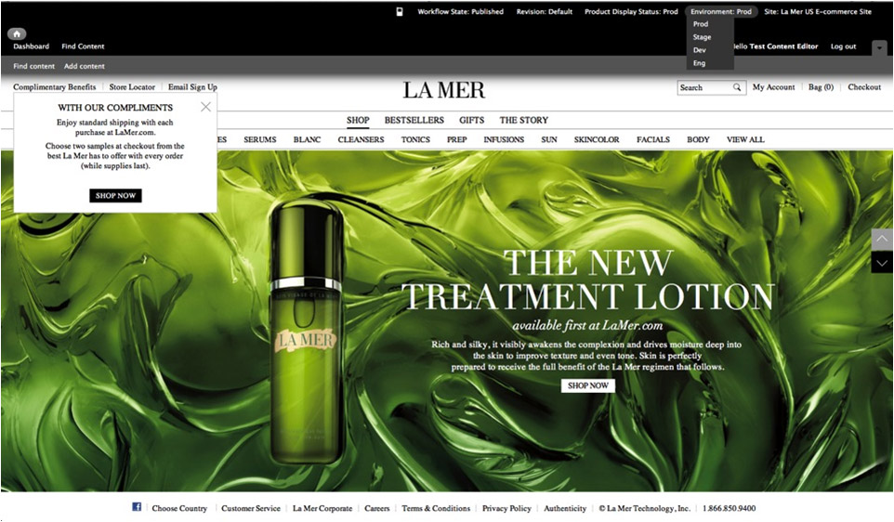
REVIEW: DEV and STAGE Environments
Notes:
On occasion, you’ll need to review your updated content on the Dev or Stage environments. This is necessary when code has been updated but has not yet synced to the Prod environment. To do this, use the Dev & Stage URLs given at the beginning of this presentation, or if you are already logged into the CMS, change the environment from the dropdown menu.
Please remember NOT to enter content on these environments, as it will erased during the hourly sync. Content changes should be made ONLY in the CMS. They will sync to the lower environments every hour.

Slide 41
Editing Drupal Content Questions
What are the steps in the Drupal CONTENT workflow?
What must you do before editing any content to make sure you have a backup in case you make a mistake?
What is the best practice naming convention for a revision tag?
You accidentally made a mistake in the content you published to production. What do you do to fix the mistake?
How do you view your changes with product catalog changes that might only be on dev or stage?

Slide 42
Editing Drupal Template Code
Notes:
Since it’s the newest topic, let’s start with editing content and code in Drupal.

Slide 43
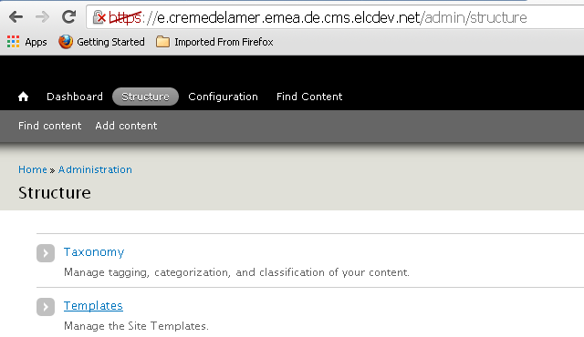
Accessing Templates
To access templates through Drupal interface, go to Structure > Templates
Template Editor role is required to access templates.
Contact the ELC Online admin for access.
Notes:
To access templates through Drupal interface, go to Structure > Templates
You can access template code by line command on your personal DrupalGem server but as I mentioned, it’s best practice to edit templates through the DrupalGem UI so you don’t have to wait for a DrupalGem code integration manager to integrate your changes to review them.

Slide 44
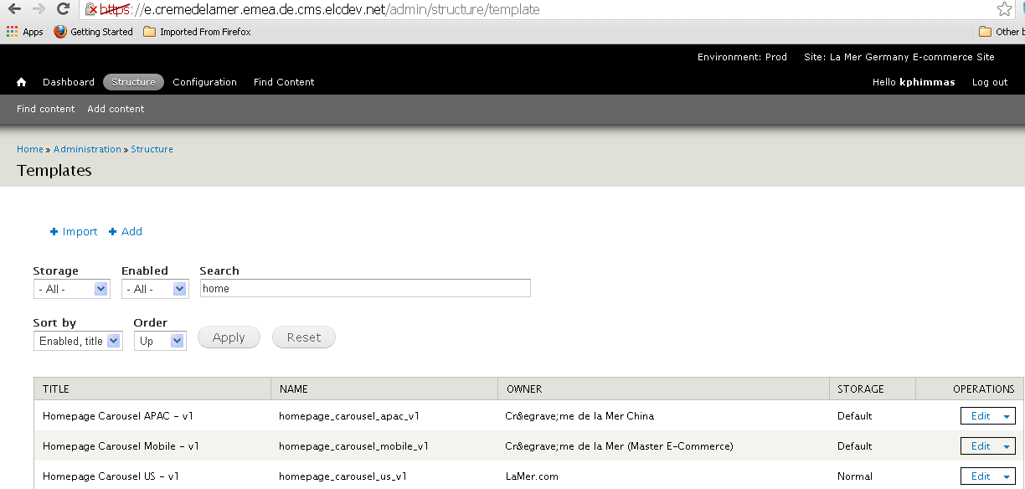
FIND: Homepage slide template
By default, all templates will be listed when you click templates with ability to search at top.
Notes:
Enter keyword 'homepage' to find HOMEPAGE BASIC APAC - V1 then click the 'Apply' button to see all matching results.
Under operations, you have the ability to edit, clone, export or view the node (template) usage.
A note on the other items on this page and whether they will be meaningful in your work.
Owner - This defines who created the template.
Import/Export – Don’t use import to import code into a template, but you can use export to download code from a template.
Storage – This is not important for you to use. Default means the code was first created through a line code. Normal means the code was input through the Drupal User Interface.
Enabled – This is not important for you to use. We currently don’t disable templates.

Slide 45
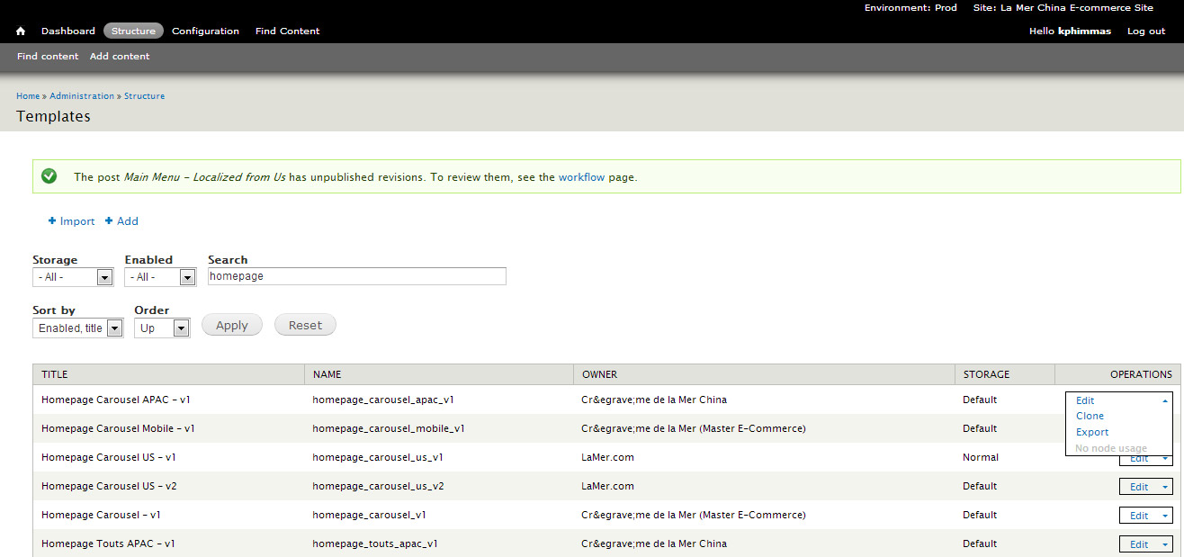
CLONE: Homepage slide template
Notes:
Under operations, you have the ability to edit, clone, export or view the node (template) usage
EDIT allows you to edit the template. Please note, you are not allowed to save changes to a template that is used in published content.
CLONE makes a copy of the template. You can’t edit a template used by published content – you must clone it so as not to affect the published template.
If multiple locale sites or pages are using the template, and you only want to change it for one page, you can clone it and update that one page without affecting all the others.
EXPORT just exports the template’s code
NODE USAGE allows you to see a list of everywhere a template is used across a Brand

Slide 46
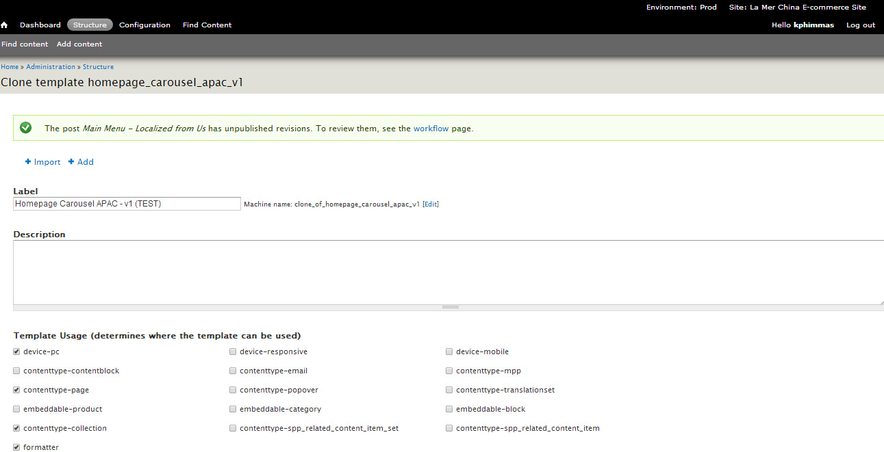
Template Label, Description and Usage
Notes:
According to best practice, you have made a clone of the your template before editing it.
You will be asked to give the page a name. Please follow these naming conventions for templates.
Label: {Descriptor} - {Device} - {Region} - {Site type} - {version}
{descriptor}: required. Value varies but describes template (i.e. grid, two column, etc).
Should not use the 'template type' values, which will be implemented via dropdown & contain options like 'general,' 'store locator,' 'product,' 'diagnostic tool'
{device} optional. Only needed if the template is 'Mobile' or 'Responsive'
{region or country}: optional. Only use if this template is region or country specific. Region can be: APAC, EMEA, LA, NA. Country can be any country: US, UK, AU, JP, CN, etc.
{site type}: optional. Only used for coresites where there is a coresite-specific alternate template. Value: coresite.
{version}: required. Used for each version of the template: v1, v2, v3, etc.
Examples:
Homepage Tout - v1
Homepage Tout - APAC - v3
Store Locator - Mobile - v2
Watch out for:
Template machine name should never begin with 'clone_of' - remove this if you clone a template via interface
The Brand name does not need to be in the template name, because all templates are Brand-specific
Description is optional and is not used anywhere on the customer facing site, but we highly recommend using it to keep track of what the templates are for, & when we roll out an enhanced template chooser UI, it will display.
Template Usage Definitions
Here is a list of all tags currently in use (this list is subject to differences between brands). Template usages are naturally defined at the platform level since all content types are global. If a brand had a one-off content type for some reason, then an additional tag (contenttype-<new ct>) would need to be accounted for.
Tags beginning with 'device-' will enable the template to be used on pc, mobile, or both.
device-pc - Only shows on the Content tab of nodes
device-responsive - Shows on both the Content and Mobile tabs of nodes
device-mobile - Only shows on the Mobile tab of nodes
Tags beginning with 'contenttype-' determine which content type(s) the template may be used on. The string value after 'contenttype-' must match the machine name of the content type.
contenttype-collection - Only shows on collection content types
contenttype-contentblock** - Example is the La Mer complimentary benefits overlay. Only shows on Content Block (elc_nodeblock) content types
contenttype-email** - Only show up on emails content types
contenttype-mpp** - Only shows on MPP (elc_mpp) content types
contenttype-page – Pages automatically render the site’s default global header and footer. 'Page' refers to the body of the page.
contenttype-popover - Only shows on popover content types
contenttype-translationset** - This is text that is pulled into product pages that were previously resource bundle keys. An example is Begin Skin Consultation
HOW MAY WE HELP YOU?' text on the La Mer product page.
Tags beginning with 'embeddable-' will enable the template to only be used for embeddables, The string value after 'embeddable-' must match the machine name of the content type. These are currently not used on La Mer or Jo Malone.
embeddable-product - Only shows on embeddable products
embeddable-category - Only shows on embeddable categories
embeddable-block - Only shows on embeddable blocks
'formatter' tags will enable a template to be used as a formatter for all content types it is tagged for using the contenttype- tags, and will not be used for the pc or mobile content fields

Slide 47
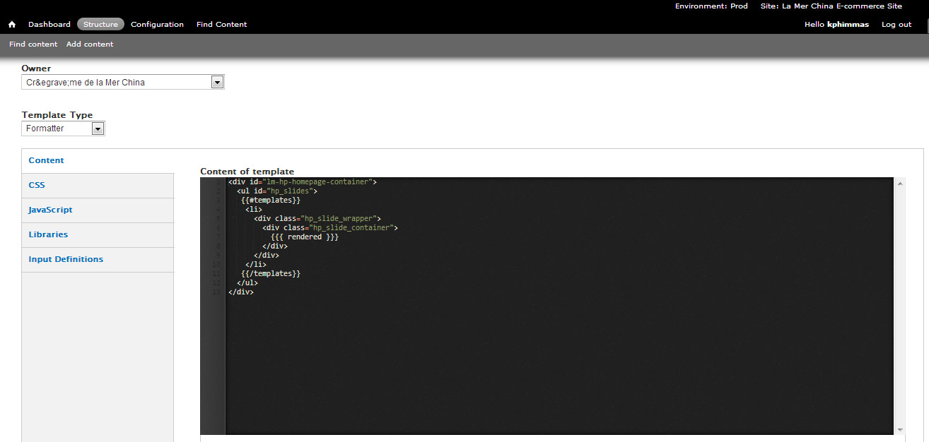
Template HTML content
Notes:
Owner defaults to which site you are in.
The template type dropdown only has an organizational purpose. It’s not used for any function on the customer facing site. The formatter type shown here is a “formatter” which you can think of as “wrapper” code for the content. In this case, this “formatter” code plays the slide content. A formatter is a type of template.
By default the HTML of the template is shown.
As you can see in this example, the code snippet is editable here.
Anytime you see brackers like this {{#templates}} or {{{ rendered }}}, this is calling a input definition that is dynamic. You can find and use all available input definitions in the 'Input Definitions' tab.

Slide 48
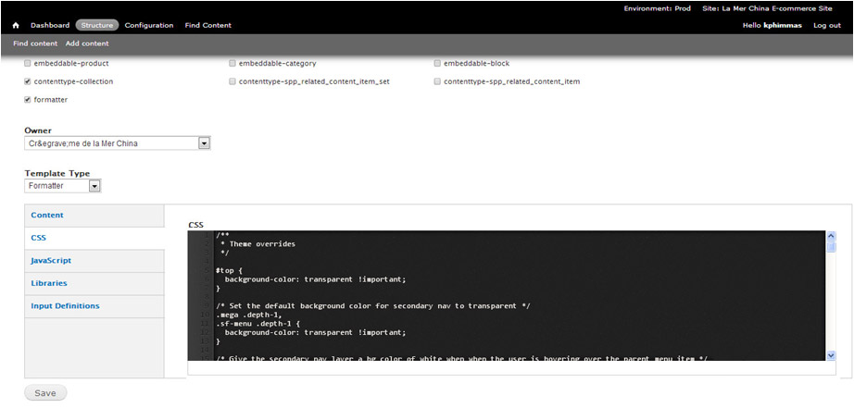
Template CSS
Notes:
If you click the 'CSS' tab for this template, you will see the CSS used for this particular template. You can edit the CSS on the page and save changes. If you make changes through the production Drupal CMS, the template changes will sync down every hour like content does. This saves you from having to go through an drupal code integration manager to merge your changes, so it’s highly recommended that you make changes through the Drupal CMS UI as much as possible.
PLEASE NOTE: There was a bug where the actual CSS code is not being pulled by default into this view so you may see remnants of this in older templates. To correct this, you must access the CSS itself through a line command and copy into this window to make changes. If you are not an engineer with access to directly to the server, you must get the code from someone who has that access.

Slide 49
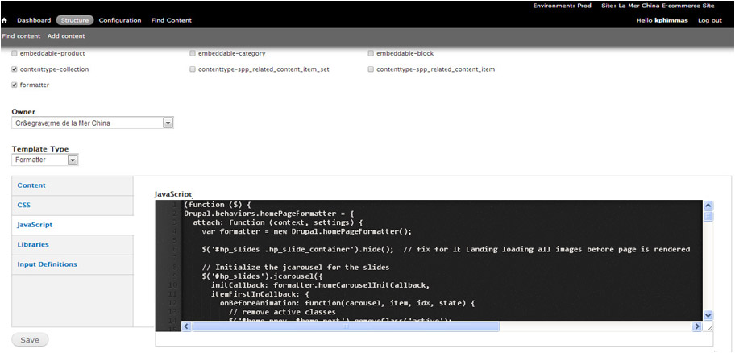
Template javascript
Notes:
If you click the 'JS' tab for this template, you will see the JS used for this particular template. You can edit the JS on the page and save changes. If you make changes through the production Drupal CMS, the template changes will sync down every hour like content does. This saves you from having to go through an drupal code integration manager to merge your changes, so it’s highly recommended that you make changes through the Drupal CMS UI as much as possible.
PLEASE NOTE: There was a bug where the actual JS code is not being pulled by default into this view so you may see remnants of this in older templates. To correct this, you must access the JS itself through a line command and copy into this window to make changes. If you are not an engineer with access to directly to the server, you must get the code from someone who has that access.

Slide 50
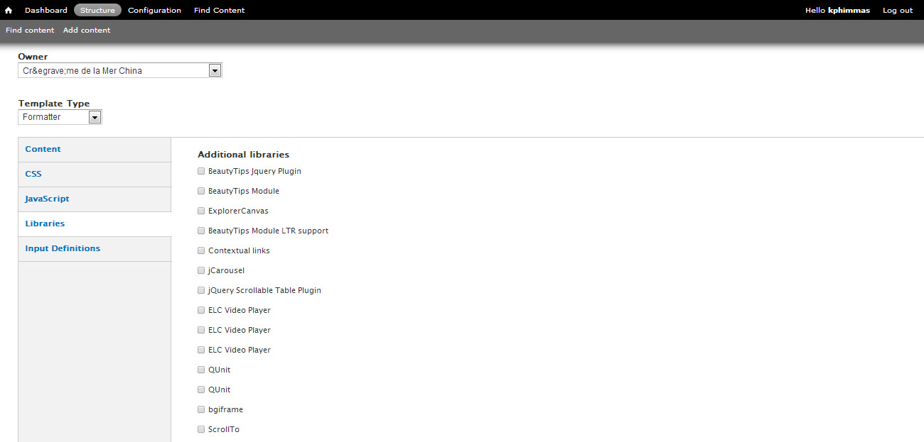
Libraries (JS) available to templates
Notes:
If you click the 'Libraries' tab for this template, you will see all the available javascript libraries from all ELC online sites. You can embed any of these JS libraries by clicking the checkbox next to it.
Libraries are defined in code via hook_library. Although the template_field module requires the Libraries API module to function, the list of available options to templates comes from the core system. I believe duplicates are possible in core.

Slide 51
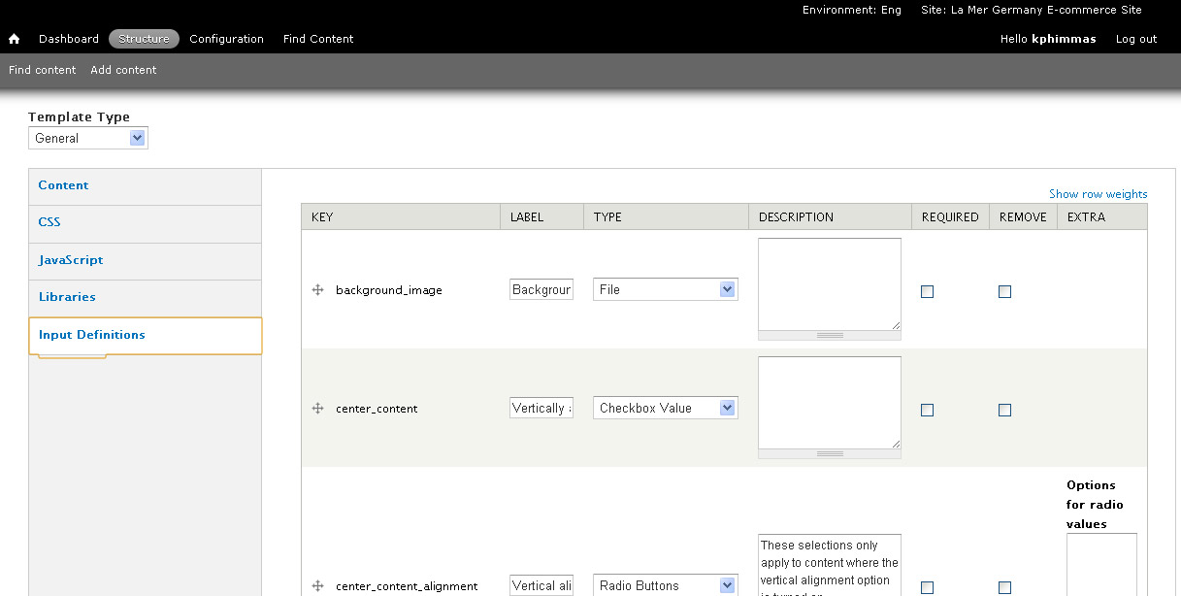
Template Input Definitions
Notes:
Whoever creates the template - an engineer or an agency - defines which fields get applied to a template or formatter. That can be done in code, or through the UI provided. Templates and formatters can both have as many fields as they'd like. However, formatters by their nature have less since they're just "wrappers" for other templates.
Label is the title for the editable area.
Type is the type of content.
Description appears below the title and provides direction on what can be done with the content.
Required makes the content required for saving
In this example, we see that the slide background image can be edited, the alignment of the content can be controlled and the title entered.
Here’s a link to how to define input definitions.
https://engwiki.esteelauder.com/twiki/bin/view/ELC2/TemplateNamingConventions#Template_Field_Names_Key_column
Standard input definition field naming for similar field types, so that in the CMS interface, the CMS user can switch from one template to another and the content will smartly populate in the new template based on the matching field names.
Use the same input definition field names for PC & Mobile version of the template, so that user can choose the 'Mobile' version of the template on the 'Mobile' tab and have the content automatically populate into the correct fields.
Here's a list of common template field keys:
Background
background_image
background_image2
background_image_x
background_image_y * Button
button_text
button_url
button_text_color
button_text_color_hover
button_background_color
button_background_color_hover

Slide 52
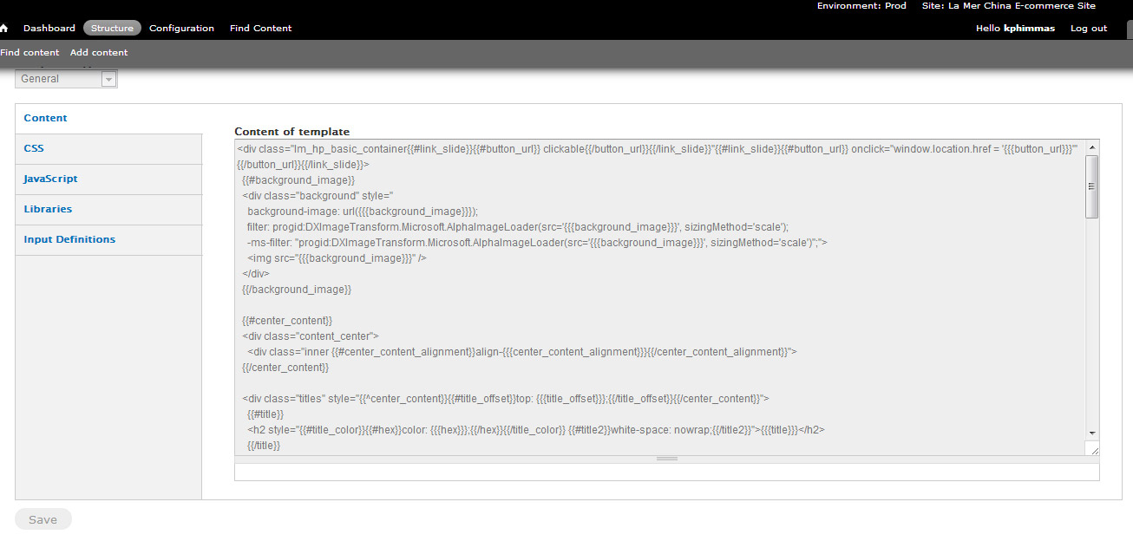
Save Template Changes
Notes:
After you’ve made all the changes you need, click 'Save' at the bottom of the page.
The templates use “mustache” markup which is noted with {{ }} or {{{ }}} . These note where input types are inserted into the templates. For example, you’ll see {{#background_image}} in the markup which means the template is calling and getting whatever was input into the template as content.
You can read more about mustache markup here.
http://en.wikipedia.org/wiki/Mustache_(template_system)
http://stackoverflow.com/tags/mustache/info

Slide 53
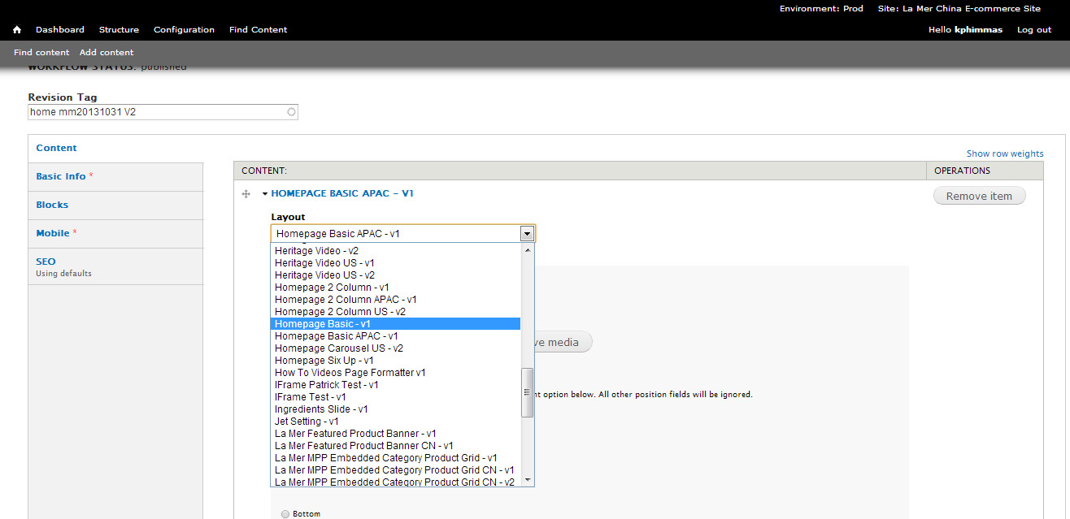
Use the template in published content
You must call the template in a DRAFT REVISION to review it.
Notes:
After saving the template itself, you must then use it in a draft revision of content. Please note that you must also have Content Editor permissions to do this. Users who are just Template Editors cannot create or edit content.
Find the content where you want to use the template and make a new draft revision.
In the draft revision, select the new template and populate its content. If you used the same input definitions as an existing template the content will be carried over. Input the template’s content then follow the content workflow of saving the revision, reviewing the changes with a revision tag, approving the revision, then publishing the revision.
Keep in mind the change will take 10 minutes to appear on production and another hour to appear on eng, dev and stage environments.

Slide 54
Drupal TEMPLATE CODE Workflow
USE TEMPLATE
IN CONTENT DRAFT REVISION
REVIEW
CONTENT
APPROVE
CONTENT
PUBLISH
CONTENT
CLONE
EDIT
LIVE in 10 min
ALL ENV in 1 hr
UN-PUBLISH
Removes the page from the LIVE site
Version still exists as a revision
VERSIONS
Notes:
Here is the Drupal TEMPLATE CODE workflow.
This is different from the current workflow on PerlGem because you need to create a content draft revision using your template in order to review new code changes. You can edit Drupal template on an engineering personal server, but it’s best practice to login to the Drupal CMS UI to clone and edit the template code. The biggest benefit of this is that your template code changes will be available on all environments and not have to be manually integrated by a DrupalGem Code integration manager.
The first step you should take when you want to change a template is to make a clone (e.g. copy) of it. This way, you will have a backup of the template.
After you’ve made a clone of the template, you can go in and edit it.
After you are happy with your edits and have saved them, you need to create a draft revision using the template through the content workflow which includes creating a new draft revision, using the template in the new draft revision, editing content, approving content then publishing content.

Slide 55
Editing Drupal Template Code Questions
What are the steps in the Drupal TEMPLATE CODE workflow?
What must you do before editing any template code to make sure you have a backup in case you make a mistake?
True or false: To be able to review template code changes, you must call the template in a draft revision
True or false: The CSS and JS under a template is used for that template only.
True or false: You can edit a template that is published.

Slide 56
Getting enhancements from another site

Slide 57

Master
Source of the master site is evolving but conceptually Master is the site used for copying to other sites.
**Coresite master and Commerce master sites different instances
La Mer Commerce Master Site
La Mer US
La Mer UK
La Mer China
La Mer Japan
La Mer Australia
La Mer Germany
Notes:
When looking at how best to get a new enhancement from a site, it’s a good time to discuss the concepts of 'Master Site' and 'Inheritance'.
First let’s talk about the 'Master Site.' Each brand’s E-commerce site is built off of the Brand Master site. This the baseline English language site. It is based off of the US site and contains content and templates that can be copied to other sites. The source of the master site is evolving it is conceptually the site that is used to copy from for other sites.
Please note that the coresite master and the E-Commerce master sites are currently different from each other.

Slide 58
Inheritance
Each Site automatically inherits Platform & Brand code
Locale Site code can override Brand code for that Locale Site only
Brand code can override Platform code for that Brand only
SITE CODE
Maintenance
Engineer
SITE CODE
Maintenance
Engineer
SITE CODE
Maintenance
Engineer
SITE CODE
Maintenance
Engineer
SITE CODE
Maintenance
Engineer
SITE CODE
Maintenance
Engineer
BRAND CODE
BRAND CODE
PLATFORM CODE
DrupalGem Platform Team
Notes:
When a brand site for a specific locale is created, it can inherit the content by 'localizing from' the Master or any other instance of the brand site.

Slide 59
Getting content from another site
You should not rebuild content if it exists on another site. You must localize it from the other site.
You can localize content from another site when the content does not yet exist in your local site.
If content does exist on your site, you should edit it.

Slide 60
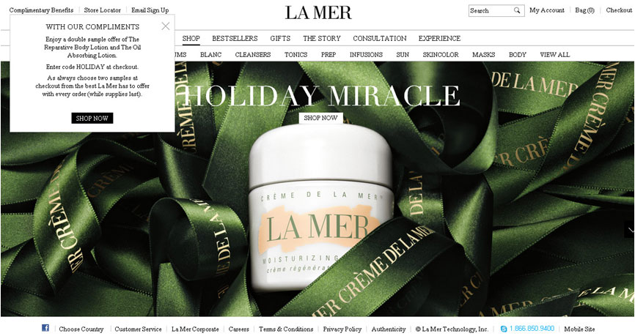
Getting content from La Mer US
Notes:
We’re going to localize the complimentary benefits overlay from the La Mer US E-Commerce site as an example of how to localize content.

Slide 61
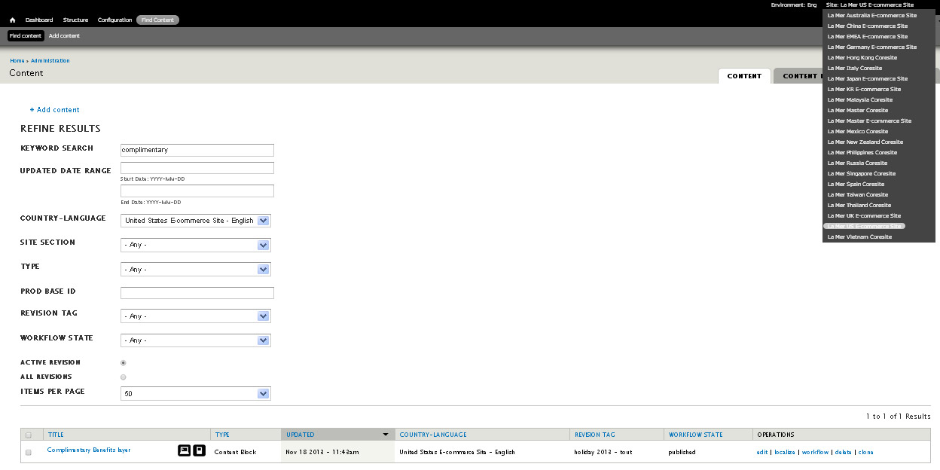
Finding content to localize
Notes:
To localize content through the Drupal CMS, you first need to login:
https://e.cremedelamer.cn.cms.elcdev.net/user
Once you log into the CMS, make sure you are in the 'Prod' environment. In the dropdown in the upper right, you can browse the content of all other locale sites. You can not edit them if you don’t have permissions, but you can localize content from another site you can navigate to from the dropdown. Select ‘La Mer US E-Commerce’ site
Click the ‘Find Content’ link in the CMS navigation.
3. Enter the keyword ‘complimentary' to find every piece of content related to the complimentary benefits overlay.
4. Click filter and you will see content that matches your search below.
5. Click the ‘Localize’ link next to the “Complimentary Benefits Layer’ content

Slide 62
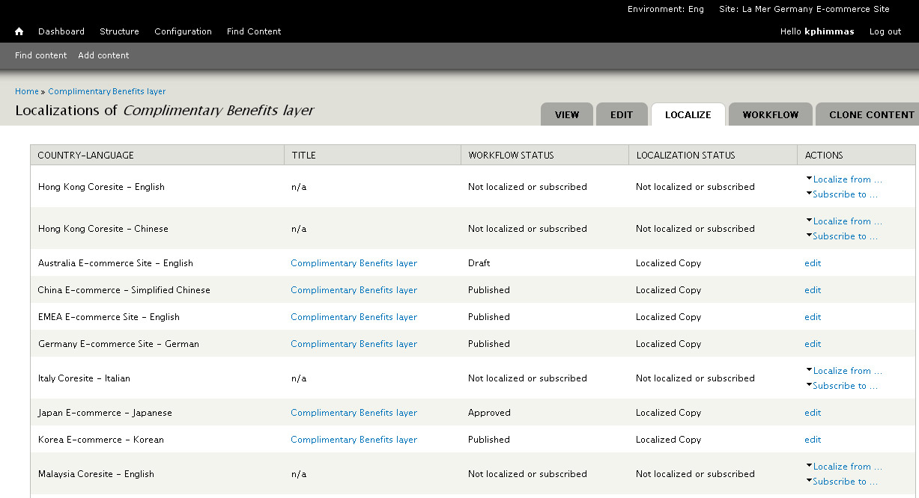
Finding content to localize
Notes:
You will see a page of all the brands’ local sites.
Next to each site, you will see if ‘Localization Status’ and actions next to the status.
If the content already exists in a locale, you will see an ‘Edit’ link because you can only localize content once.
If the content doesn’t exist, you can click the ‘Localize from…’ link which will allow you to select which locale you want to localize the content from. Localizing content will bring the content over with all content links so you will just need to go in and customize content for your locale instead of recreating it from scratch.

Slide 63
Inheritance Best Practices
QA Testing and Communication
Locale Site code changes need to be tested on that Locale Site only
Enhancements
Locale Site code changes need to be tested on that Locale Site only Local sites should localize content from another site (most times the US), not recreate content or other enhancements
Bug Fixes
Make bug fixes to one locale site only
Platform Changes
For Platform level changes, contact the global brand team or Drupal Platform team

Slide 64
Subscription (country chooser only)
We don’t recommend subscribing to content from another site EXCEPT in the case of country chooser.
The only time the sites are using this is for the Country chooser page where there is not much divergence between locale’s sites.
Go to ‘Find Content’ in the US locale site
Search for ‘Country’
Next to the ‘International Country Chooser’ content, click ‘Localize’
On the page that lists every brand’s locale sites, go to the site you want to have subscribe to the US country chooser and click ‘Subscribe to…’ and select the US site
You will be asked to confirm ‘Subscribing to en-ECOM will create a new node. This node can not be updated manually until the content is localized’
Click the ‘Subscribe’ button to confirm

Slide 65
Getting Enhancements from another site Questions
What is the concept of master?
What is inheritance and how do we use the concept to localize content from other sites?
What is subscription and when is the only time it is currently used on our sites?
When can you NOT localize content?
Can the content relationship between a brand’s sites be broken?

Slide 66
Alfresco

Slide 67
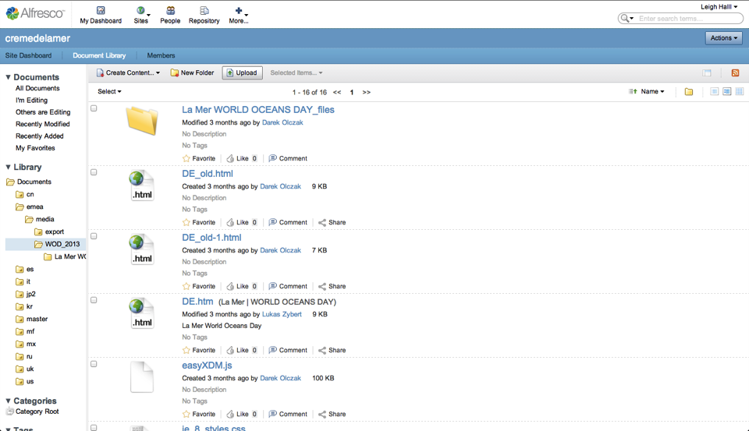
Bulk Loading Assets to Alfresco
Notes:
The second way to upload new assets is using the Alfresco site under your specific locale. This method is recommended for bulk uploads, large file uploads, and general asset management.
Log in to the Alfresco portal using the URL with your username and password given to you by the ELC Online admin. It’s the same one you use for Drupal CMS, offer manager, RB Editor and your personal server.
http://alfresco.elcdev.net/share/page/
Once you are logged in to your locale, click the ‘Upload’ button, and upload the image you want to update.
After you finish uploading the image, you need to go back to the edit content screen on the CMS, and select the image you just uploaded by clicking the ‘Select Media’ button.

Slide 68
Resource Bundle (RB) Editor

Slide 69
RB Editor Definitions
Resource Bundles – Resource bundles are files that contain pairs of keys and values. Templates display specific key values. Each key has a English and local language value. These keys are tied into templates so the value associated with the key displays on engineered pages that are not generated by the CMS. Example: Resource bundle ‘error_messages’ might contain the following key value pair
Resource Bundle Editor – The editor is a browser based tool that allows the user to change the values in the bundle, create new key/value pairs, and delete existing key/value pairs.
Resource Key Toggle Tool – The key toggle tool the user to view the site in three states. Show keys, Show Inline Keys, and English values.
Key | English Value | Local Language
required.account_first_name | Please enter your first name. | 名の漢字を入力してください。

Slide 70
Show Keys
You can see keys inline on a site by adding this path to the end of an ENG or DEV URL
/shared/setkeys.tmpl
For example go to the Jo Malone US DEV site and add the extension: http://e.jomalone.na.us.dev.ncsa.elcdev.net/shared/setkeys.tmpl
Click the link on the page to “Toggle Inline Keys”
Navigate to the account or checkout in the site and you will see the key names inline on the page.
Once you find the name of a key, you can search for it in the RB editor to edit it.

Slide 71
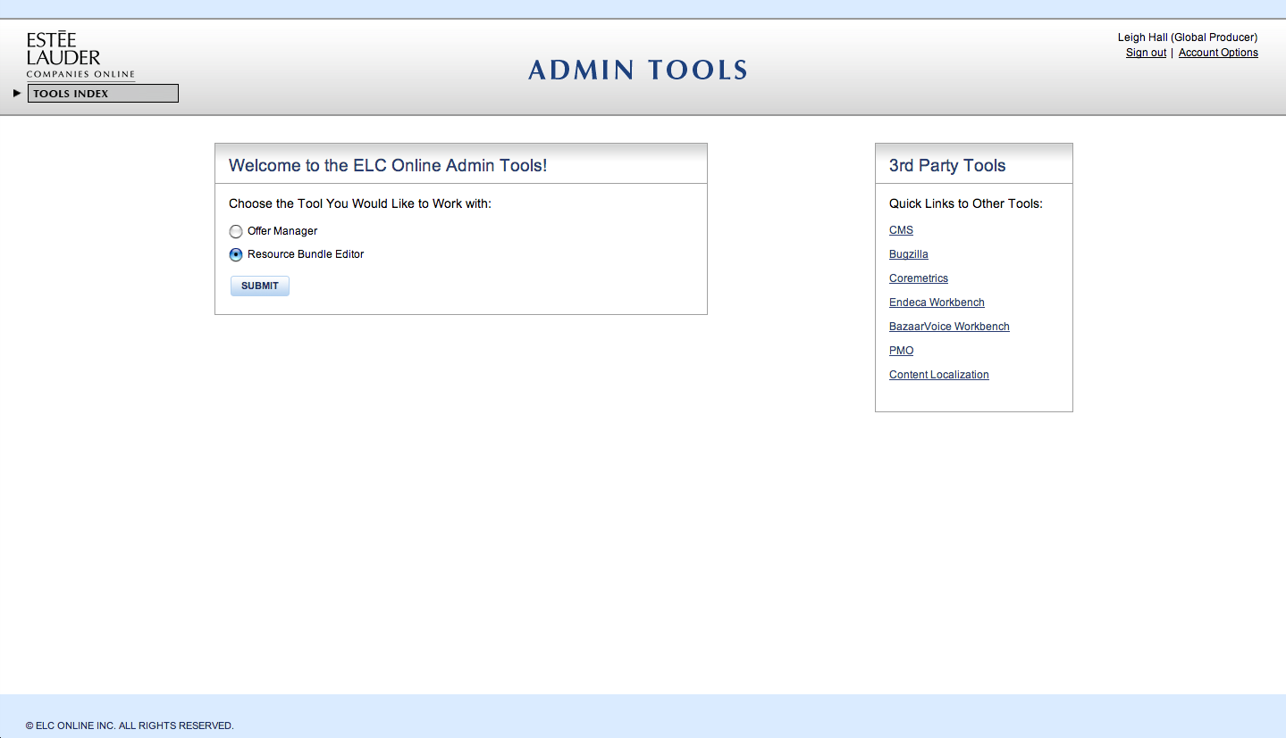
Logging in to RB Editor
Notes:
To access the Resource Bundle Editor, you must login via the tools URL.
https://tools.elcompanies.com/
Then select ‘Resource Bundle Editor’ and click the ‘Submit’ button.

Slide 72
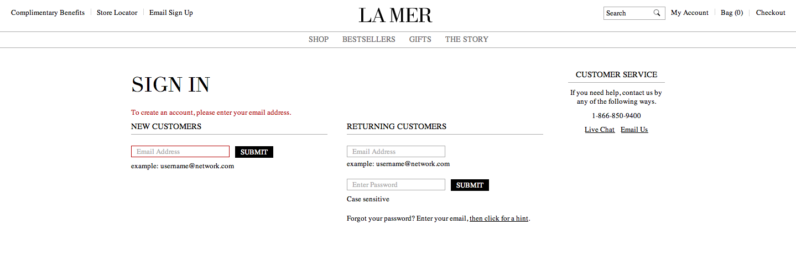
Editing Error Messages
Notes:
To begin, we’ll go over editing site values. For the purposes of our example, we’ll be editing an error message consisting of the text that displays if a site user fails to enter their email address while signing up for a La Mer account.
On the live site, it currently displays like this.

Slide 73
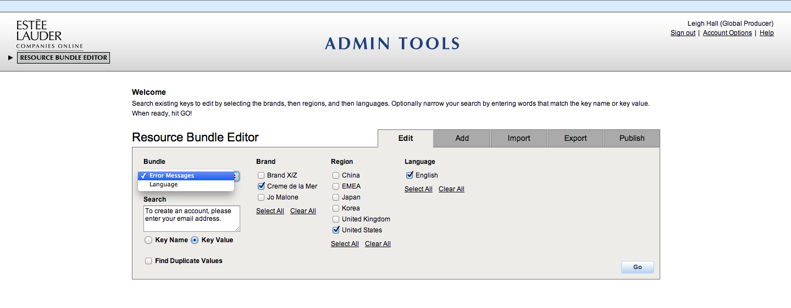
Editing Error Messages
Notes:
To edit this text, first we need to find the key in Resource Bundle Editor.
First, choose what type of bundle you’re searching for. In our case, we’re searching for Error Messages.
To narrow your search, you can optionally enter a word or string in the Search box. This string can match either a Key Name or Key Value - select the radio key accordingly. For this example, I’ve chosen to enter text from the key value in order to find the key.
Next, select the brands you want to search.
Check the checkboxes next to the Brand name to show the Key values specifically for those brands. You can choose multiple brands by checking the checkboxes associated to the Brands and you can also select all the Brands by clicking on ‘Select All’. To clear your selection, simply click on ‘Clear All.’
Since this key is on the La Mer site, I’ve chosen La Mer.
Once you select the brands you will see various regions associated with those Brands. You can select the regions by checking the checkbox next to the region. After selecting the regions, a language list will be available. This list shows the different languages associated to the Regions selected. You can select one or multiple languages. For this example, I’ve chosen United States and English
Once you are done selecting your criteria, click Go.

Slide 74
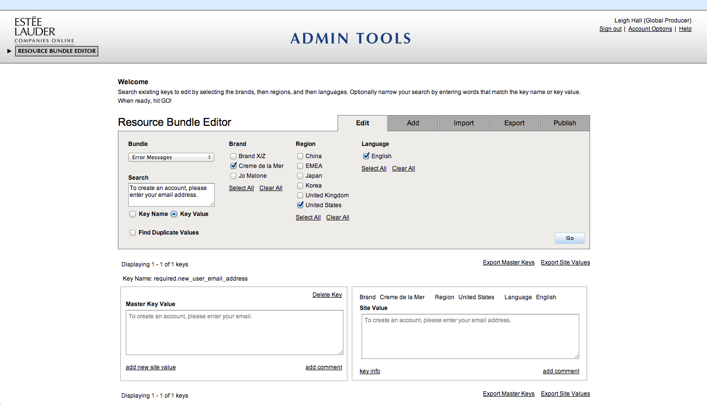
Editing Error Messages
Notes:
The resulting page looks like the image shown above. The key we were looking for shows up as the only result:
Key Name: represents the name of the Key.
Master Key Value: The box titled Master Key Value on the left side is the Master Key Value box. It contains the English wording for the Key that most common across markets.
Site Value: The box on the right side of the Key name is the Site Value Box. It contains the value of the key for the site(s) selected, in this case La Mer US.

Slide 75
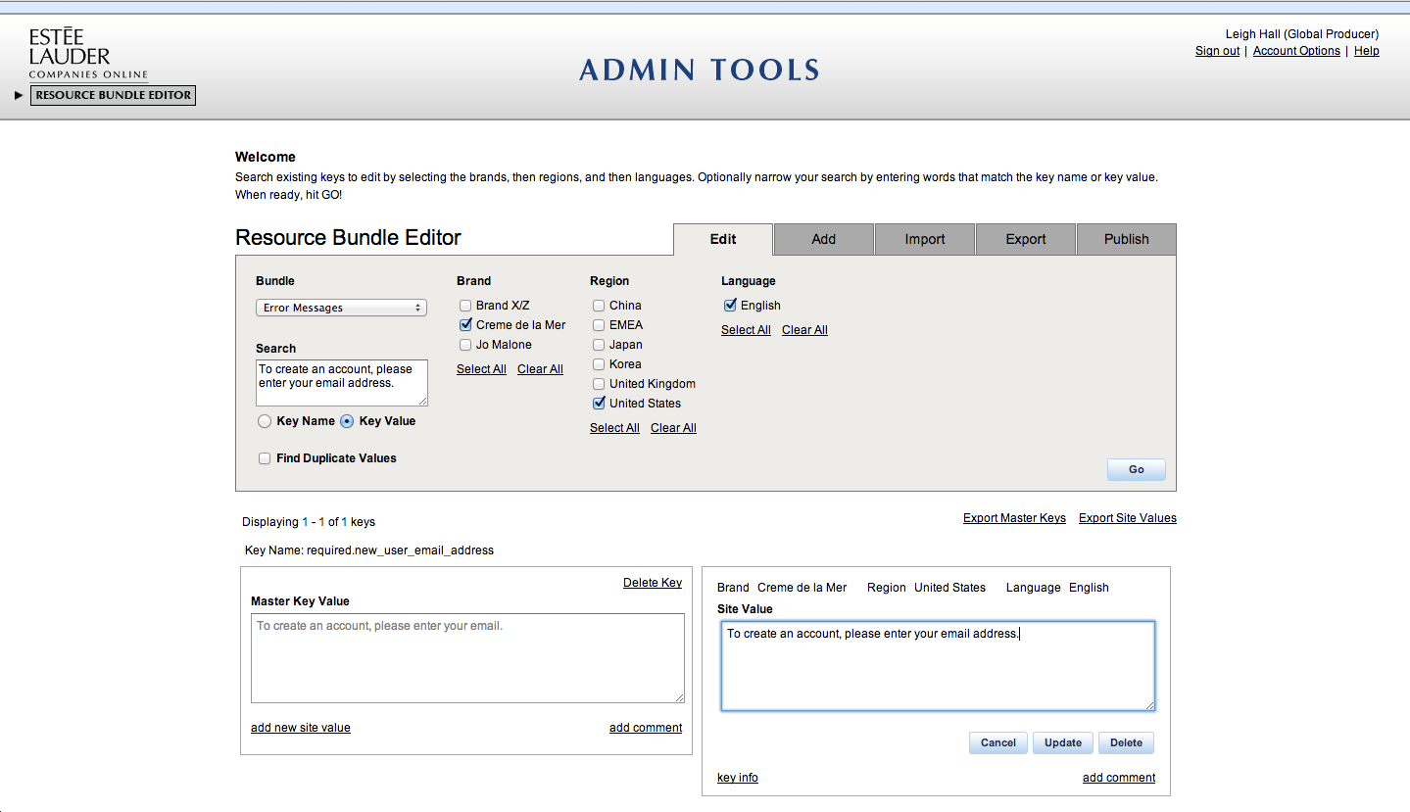
Editing Error Messages
Notes:
Now you can edit the Site Value by clicking on the body section of the Site Value box. This would make the text available for modifying. Then:
Type in the new text into the body section.
If you do not wish to keep the changes you made, click ‘Cancel’ to erase the changes.
Click ‘Update’ to update the Site Value with the new value you have entered.
You will see a confirmation message saying the Key values have been updated.

Slide 76
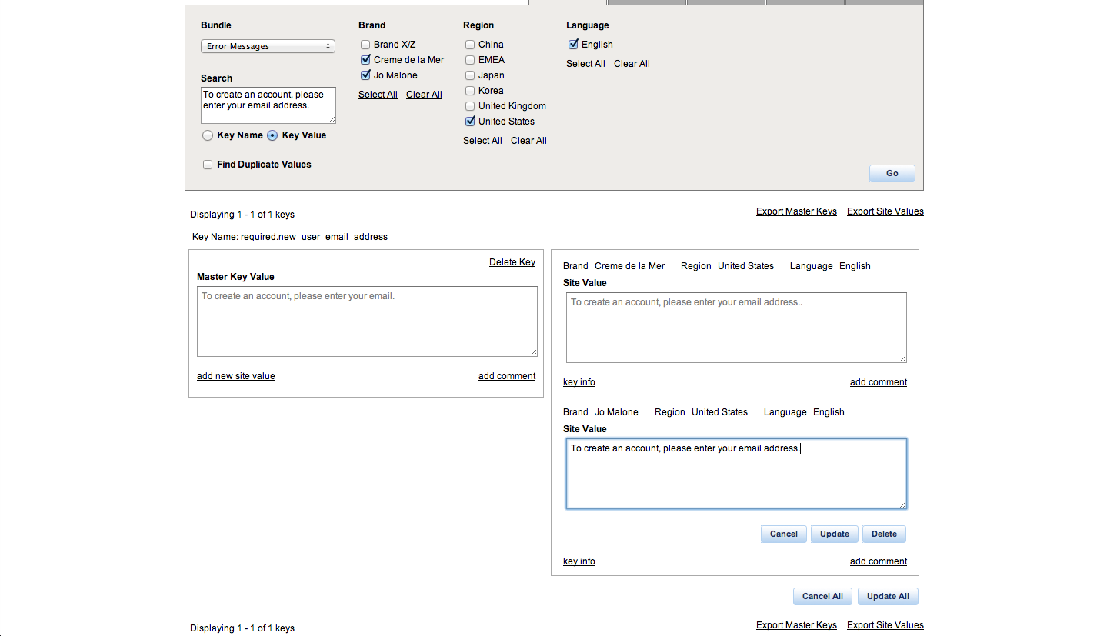
Editing Error Messages
Notes:
If you need to the value of a key for multiple sites, you can do so by selecting additional brands/regions/language and making your changes as we just described.
Do not click ‘Update’ when you are done updating one Site Value. If you click on the Update button on one Site Value, you will update only that Site Value and you may lose other unsaved updates. Instead:
Click on the body section of the next Site Value of the same Key that you wish to modify.
Follow the previous steps until you have modified all the Site Values you need to.
If you do not want to keep the changes you made to any of the Site Values, click on ‘Cancel All’ to erase all the changes you made to all the Site Values.
Click on the ‘Update All’ button outside the exterior border of the Site Values to update all the Site Values with the new values you have entered.
You will see a confirmation message saying the Key values have been updated.

Slide 77
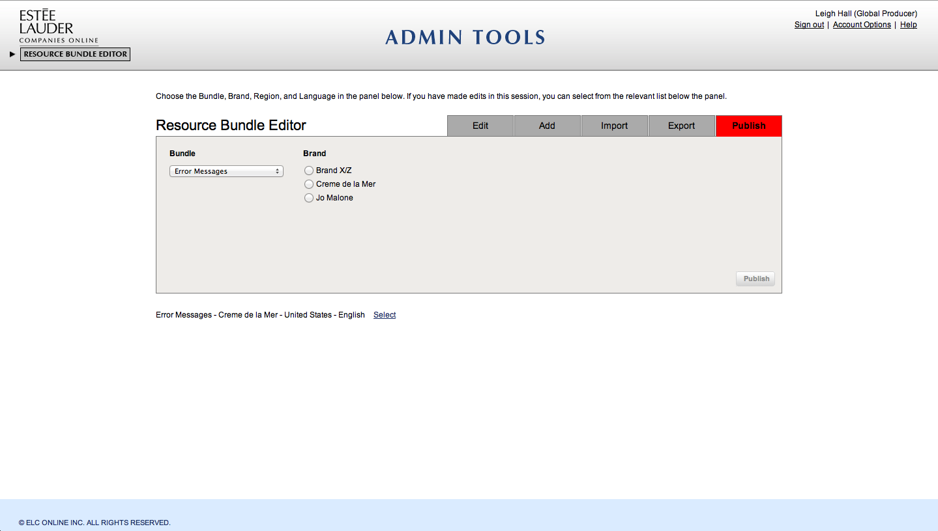
Publishing
Notes:
After you’ve made your changes, you need to publish them. The Publish tab allows you to publish the changes to the Brand sites. All the changes that have been made will be saved on the database if the user publishes them, else none of the changes will be saved on the brand sites.
When you make changes, the publish tab turns red to alert you that you need to publish them. To publish your changes:
Select the Bundle to which you have made changes and want to publish the changes.
Select the brand, then region, and lastly language to unveil the Publish.
Click Publish.
The changes you made will now be published to the brand, region, and language that you have selected.

Slide 78
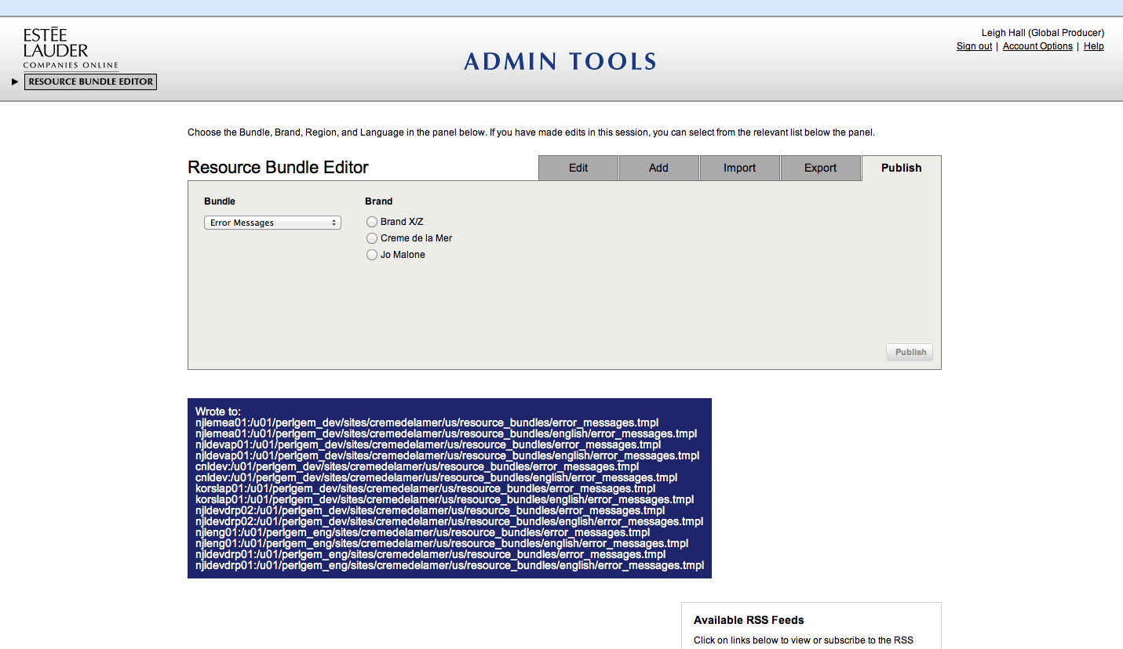
Publishing
Notes:
Our site value has now been updated!
Your updates will publish in an RB file to the Eng and Dev environments simultaneously (within seconds!)
The file will need to be manually pushed to the Stage and Prod environments by a user with Push Tool access.

Slide 79
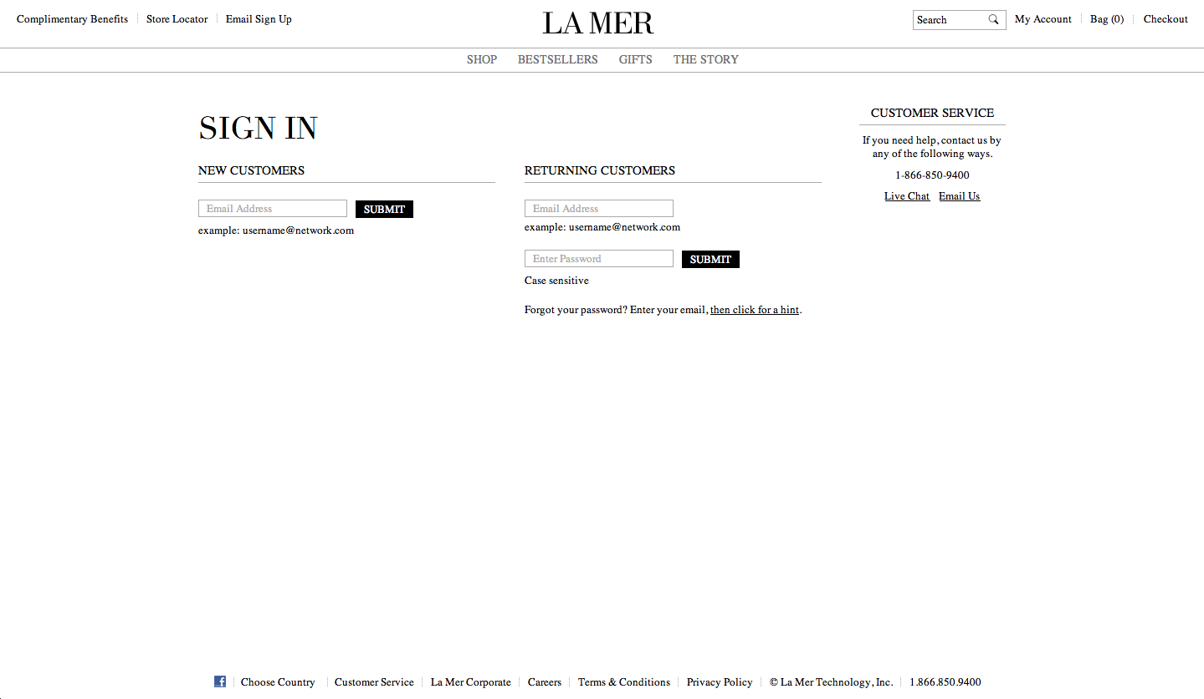
Adding a New Language Bundle
Notes:
Now we’ll go over how to add new site values. For this example, we’ll add a new Site Value to a language bundle. Language Bundles include text for the following:
Page headers and page titles of .tmpl pages (mainly Account & Checkout)
Page descriptive text on .tmpl pages
Text links on .tmpl pages
Field names (excluding fixed pull-down list items) on .tmpl forms
Our example will be adding the Live Chat text link to another region.

Slide 80
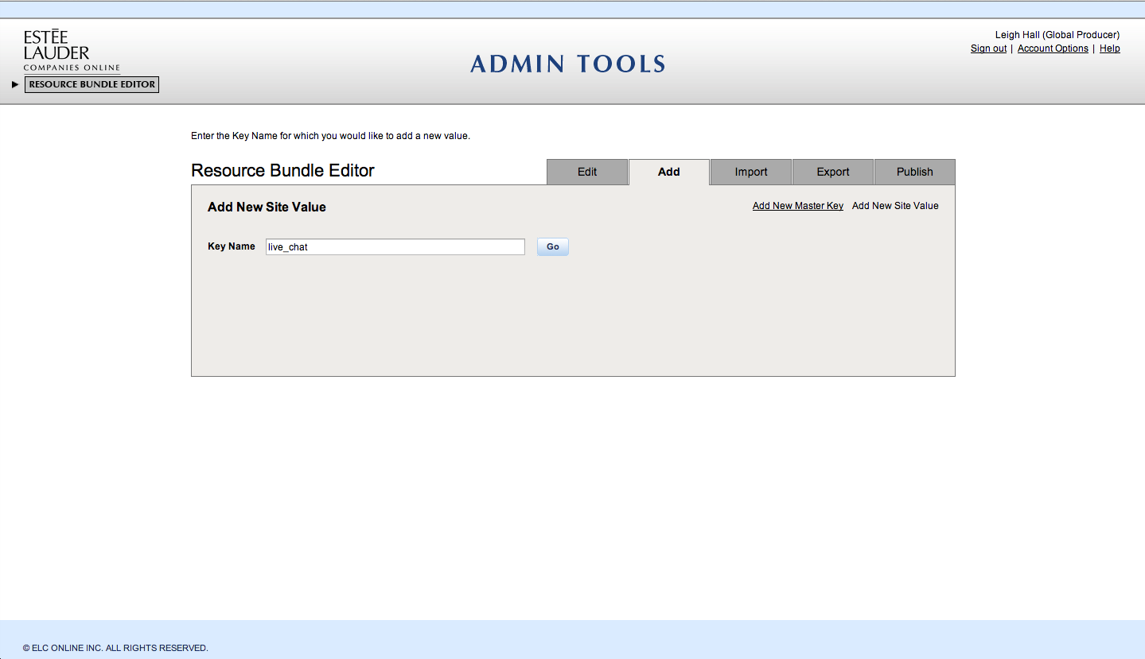
Adding a New Language Bundle
Notes:
First, click on the 'Add' tab and then click on the 'Add New Site Value' link.
Now we need to search for the existing key to add the site value to.
Type the key name into the search box - in this case, it is 'live_chat' - and click the 'Go' button.

Slide 81

Adding a New Language Bundle
Notes:
This opens up the list of Brands. Select the brands, regions, and languages you want to add to.
For our example, we’ll select La Mer, United States and United Kingdom, and English.
After you have made your selections, click the ‘Go’ button.

Slide 82

Adding a New Language Bundle
Notes:
This shows us the site values for United States and United Kingdom under the ‘live_chat’ key.
The United States already has “Live Chat” text but the United Kingdom currently has no site value for this key.

Slide 83

Adding a New Language Bundle
Notes:
Click on the body section of the site value and type in your text – in this case, we’ll match it the United States and enter “Live Chat.”
When you are done, click the ‘Submit’ button.

Slide 84

Publish
Notes:
RB Editor will alert you that you have added a site value and need to publish it. Notice that the Publish tab also turns red.

Slide 85

Publish
Notes:
Click on the Publish tab and follow the same steps we used previously to publish the new changes. As I noted before, your updates will publish to the Eng and Dev environments simultaneously, but will need to be manually pushed to the Stage and Prod environments by a user with Push Tool access.
Now you’ve learned how to edit and add site values during refreshes!

Slide 86
RB Editor Questions
Where do you to login to the Resource Bundle Editor?
How do you find a resource bundle to edit?
How do you add a new resource bundle?
True of False: Do you need to publish resource bundles?
True of False: Publishing makes resource bundles appear on ENG and DEV simultaneously.

Slide 87
Trouble Shooting

Slide 88
You’re not able to login
There are a few things to check if you can not login to systems:
If you were able to login before, your RSA token may need to be reset to create a new PIN
In APAC, you can contact Esther Leung or Quin Shing to reset your token.
In UK, you can contact Mark Lapicki to reset your token.
In EMEA, you can contact Mark Woods to reset your token.
If you have never been able to login, contact the elconlineadministration@estee.com (9am – 6pm NY) to make sure your access has been set up for the system and you have persmissions to view the brands/locales you require

Slide 89

I get a proxy error
On eng, dev and stage, the servers restart from time to time and you may see a “Proxy Error”.
If you see this error, try refreshing the page or wait a couple minutes and try refreshing again.

Slide 90
I see a blank page in the Drupal CMS
If you see a blank page in the CMS, scroll down the page and see if there’s any content
This sometimes happen on slower connections and the way to resolve is to refresh the page in your browser

Slide 91

Error when trying to link to image/video
I get this error when trying to link an image or video asset through the Drupal CMS.
To resolve this issue, you will need to login to Alfresco through the CMS.
In the Drupal CMS, click the hello {user login} in CMS admin navigation
Click the Alfresco tab
Click the Reset button
Enter your Alfresco username + password and click the Reset button

Slide 92
Accidentally deleted a piece of content
If you accidentally delete a piece of content from the site by unpublishing it, go to the workflow tab and republish the revision
If you delete the whole content node, try to find content in another locale for the brand and localize it from the other locale
If the content node doesn’t exist in another brand locale, you will need to recreate the piece of content from scratch

Slide 93
How to get help

Slide 94
Subject Matter Experts (SMEs)
Every team will have a set of DrupalGem subject matter experts
These DrupalGem SMEs will be the team members’ first point of contact for support and issues.
As an SME, you need to act as a DrupalGem expert to your team, prioritize and communicate issues your team finds up to the DrupalGem Platform team.
Share important news and updates from the DrupalGem Platform team with the rest of your team.

Slide 95
APAC SME Contacts
Team | Role | Name | Email | Phone | Location
Regional Maintenance | Producer | Quin Shing | qshing@hk.estee.com | 852 3756 4216 | Hong Kong
 | Engineer | Prakash Kumar | Prakash.Kumar2@cognizant.com | 852 3756 4274 | Hong Kong
Regional Development | Producer | Joanne Chan | jchan@hk.estee.com | 852 3974 4419 | Hong Kong
 | Engineer | Wayne Butcher | wabutche@estee.com.au | 61 2 9381 1294 | Sydney
APAC Drupal Code Integration Managers | Engineer | Prakash Kumar | Prakash.Kumar2@cognizant.com | 852 3756 4274 | Hong Kong
 | Engineer | Senthilkumar P | Senthilkumar.P@cognizant.com | 914445659555 | India
 | Engineer | KarthikKasi D | KarthikKasi.D@cognizant.com | 86 21 61006466x869565 | India
DrupalGem | Drupal Producer | Laura Leslie | lleslie@estee.com | 917-790-0176 | New York
 | Drupal BE Engineer | Jeff Kwok | jkwok@doubleprime.com | 407-592-2390 | Florida
 | Drupal BE Engineer | Greg Amaroso | gamaroso@doubleprime.com | 484-202-0595 | Pennsylvania
 | Drupal FE Engineer | Jeremy Donelson | jdonelson@doubleprime.com | 845-339-2829 | New York
Alfresco | Alfresco Producer | Momo Furudate | mfurudat@estee.com | 917-790-0164 | New York
 | Alfresco Engineer | Dennis Klungler | dklungler@doubleprime.com | 407-476-1420 | Florida
RB Editor | RB roducer | Momo Furudate | mfurudat@estee.com | 917-790-0164 | New York
 | RB BE Engineer | Cornel Ghiban | cghiban@estee.com | 917-790-0267 | New York
 | RB FE Engineer | James DiPina | jdipina@doubleprime.com | 339-222-7819 | Massachusetts

Slide 96
EMEA SME Contacts
Team | Role | Name | Email | Phone | Location
Regional Maintenance | Producer | Gail Welch | gail@chalkdustconsulting.com | (203) 965-0832 | New York
 | Producer | Marnie Long-Collins | mlcollin@estee-lauder.co.uk | 44 870 034 6700 | UK
 | Engineer | Siddarth Gopalarkrishnan | sgopalakrishnan@estee-lauder.co.uk |  | India
Regional Development | Producer | Cleo Godsey | clgodsey@elceurope.com | 49 (0)89 23686 406 | Munich
 | Engineer | Phil Markham | pmarkham@estee-lauder.co.uk |  | UK
 | Agency | Daniel Sibilski | d.sibilski@digitalone.pl |  | Poland
DrupalGem | Drupal Producer | Laura Leslie | lleslie@estee.com | 917-790-0176 | New York
 | Drupal BE Engineer | Jeff Kwok | jkwok@doubleprime.com | 407-592-2390 | Florida
 | Drupal BE Engineer | Greg Amaroso | gamaroso@doubleprime.com | 484-202-0595 | Pennsylvania
 | Drupal FE Engineer | Jeremy Donelson | jdonelson@doubleprime.com | 845-339-2829 | New York
Alfresco | Alfresco Producer | Momo Furudate | mfurudat@estee.com | 917-790-0164 | New York
 | Alfresco Engineer | Dennis Klungler | dklungler@doubleprime.com | 407-476-1420 | Florida
RB Editor | RB roducer | Momo Furudate | mfurudat@estee.com | 917-790-0164 | New York
 | RB BE Engineer | Cornel Ghiban | cghiban@estee.com | 917-790-0267 | New York
 | RB FE Engineer | James DiPina | jdipina@doubleprime.com | 339-222-7819 | Massachusetts

Slide 97
North America Brand Teams
Need to add

Slide 98
United Kingdom
Need to add

Slide 99
Rapid Rollout
Team | Role | Name | Email | Phone | Location
Phase 1 & 2 | Program Manager | Rags Seshadri | nseshadr@estee.com | 917-790-0047 | New York
Phase 1 | Engineer | Paul Grassie | pgrassie@doubleprime.com | 9087885564
 | Engineer | James Gardner | jgardner@doubleprime.com | 850-233-0069 | Florida
Phase 2 | Engineer | Paul Bruno | pbruno@doubleprime.com
Phase 2.5 (Stores, Endeca, Bazaarvoice) | Engineer | Mamta Bhardwaj | mbhardwaj@doubleprime.com | 917-790-0084 | India
DrupalGem | Drupal Producer | Laura Leslie | lleslie@estee.com | 917-790-0176 | New York
 | Drupal BE Engineer | Jeff Kwok | jkwok@doubleprime.com | 407-592-2390 | Florida
 | Drupal BE Engineer | Greg Amaroso | gamaroso@doubleprime.com | 484-202-0595 | Pennsylvania
 | Drupal FE Engineer | Jeremy Donelson | jdonelson@doubleprime.com | 845-339-2829 | New York
Alfresco | Alfresco Producer | Momo Furudate | mfurudat@estee.com | 917-790-0164 | New York
 | Alfresco Engineer | Dennis Klungler | dklungler@doubleprime.com | 407-476-1420 | Florida
RB Editor | RB roducer | Momo Furudate | mfurudat@estee.com | 917-790-0164 | New York
 | RB BE Engineer | Cornel Ghiban | cghiban@estee.com | 917-790-0267 | New York
 | RB FE Engineer | James DiPina | jdipina@doubleprime.com | 339-222-7819 | Massachusetts

Slide 100
REFERENCES

Slide 101
Where is it built?*
Section | PerlGem |  | Drupal
 | Front-End | Back-End | Front-End | Back-End
Global Navigation |  |  | = | =
Super Category Pages
Multi-Product Pages (MPP) |  | = | =
Single Product Pages (SPP) |  | = | =
Content: Pages, Merch Windows, Videos |  |  | = | =
Endeca Search Results |  |  | =
Endeca Search Bar with Predictive Results | =
BazaarVoice Product Ratings & Reviews |  | = | =
Email signup bar |  | = | =
Cheetahmail SMS/Email Signup | =
Store Locator |  | = | =
Customer Service |  |  | = | =
Contact Us: Page + Emails | = | =
Live Chat (LivePerson) |  |  | =
System Emails (E-Commerce) | = | =
System Emails (Coresite) |  |  | = | =
Account | = | =
Checkout | = | =
*This table is based on current La Mer build; consult your rollout kit for a detailed list and special content.
Notes:
This an example of where elements are built for the La Mer Build. As you can see, different elements are built and edited in different systems. Please consult your brand rollout kit for a detailed list and special content for the brand site.

Slide 102
References
Platform Goals: https://engwiki.esteelauder.com/twiki/bin/view/ELC2/DrupalPlatformGoals
Finding and Editing Code: https://engwiki.esteelauder.com/twiki/bin/view/ELC2/LocaleEngineers
Personal Server Setup: https://engwiki.esteelauder.com/twiki/bin/view/ELC2/DrupalPersonalServerSetup
Creating/editing templates: https://engwiki.esteelauder.com/twiki/bin/view/ELC2/TemplateUsage
Theming: https://engwiki.esteelauder.com/twiki/bin/view/ELC2/SubTheming
GIT Usage: https://engwiki.esteelauder.com/twiki/bin/view/ELC2/EngineeringWorkflows
All DrupalGem Topics: https://engwiki.esteelauder.com/twiki/bin/view/ELC2/DrupalGemDocs

Slide 103
Feedback
We welcome feedback to make the platform better. There’s a document here to enter in any feedback you have. https://docs.google.com/spreadsheet/ccc?key=0ArHw8nvNwlSxdFRSalZiaUh4NkVJcmZHeVl1U0dHcUE&usp=drive_web#gid=0
Feedback is reviewed and then prioritized for future releases which are tracked here.https://docs.google.com/spreadsheet/ccc?key=0ArHw8nvNwlSxdGFMeU5sRFgwZGJMMmtLQkJzczkzREE&usp=drive_web#gid=0

